Slide 1
Taking Action
Removal Types, Tagging, Escalations

Slide 2




Taking Action
Removal Types, Tagging, Escalations
Tripadvisor | Content Moderation Training
Notes:
Source: original slide 1 (cover).

Slide 3


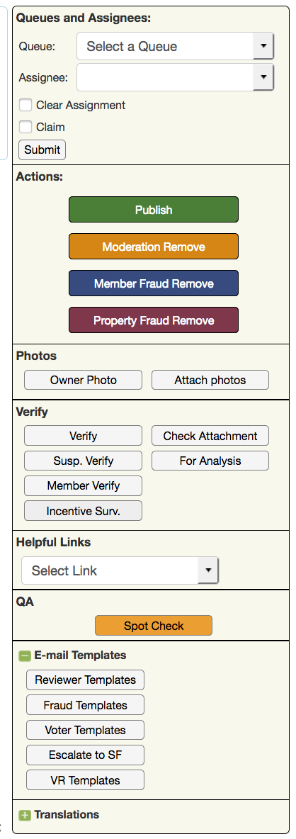
Taking Action
Removal Types, Tagging, Escalations
This module covers how to take action on reviews across three areas: removal types, tagging, and escalations.
Revamped
Taking Action
2

Slide 4
[PHOTO PLACEHOLDER]
Halong Bay, Vietnam
Fun fact: Halong Bay is a UNESCO World Heritage Site in Vietnam --
famous for thousands of limestone karst islands.
Canva search: "Halong Bay limestone karsts"
AI prompt: "Halong Bay Vietnam, turquoise water, limestone karst islands, golden hour, travel photo"
01
New
Moderation Removals
Regular Removals -- the standard set of moderation removal reasons.
1
2
3
4
5

Slide 5

Affiliation Stated in Review (1 of 2)
Affiliation to property is mentioned in text.
“I used to work here…”
“I volunteered for a summer here in 2010…”
“We own a timeshare here and the fees are outrageous…”
Revamped
Taking Action
4

Slide 6
Affiliation Stated in Review (2 of 2)
Affiliation to property is mentioned in text (continued).
“We were here on a timeshare exchange and prefer the location in Hollywood better.…”
“I interviewed at here and they were the…”
Revamped
Taking Action
5

Slide 7
AI Generated
Remove content if there are obvious AI prompts or clear AI indicators visible within the text.
“Here's a polished version of your review:…”
“From chatGPT:…”
“Sure, here's a review based on your description:…”
Revamped
Taking Action
6

Slide 8
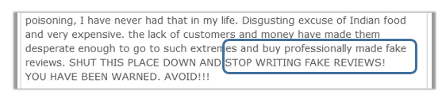
Allegation of Fraud
Statements that reviews are fake.
If the user mentions a pattern in reviews, it's important to research the lead and add a comment of your findings.
Revamped
Taking Action
7

Slide 9
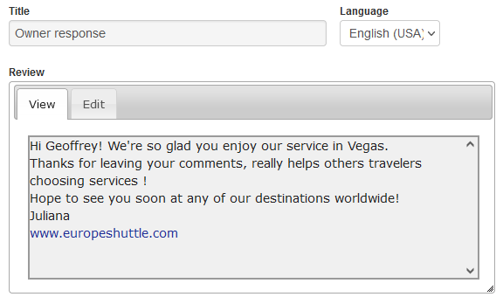
Commercial
Contains promotional information or links that are not allowed.
Revamped
Taking Action
8

Slide 10
DC Policy
A valid experience posted by property owner to competitor listing that is on the same popularity index.
Example: A restaurant owner in Las Vegas cannot write a review about a valid experience at any other restaurant in Las Vegas.
Revamped
Taking Action
9

Slide 11
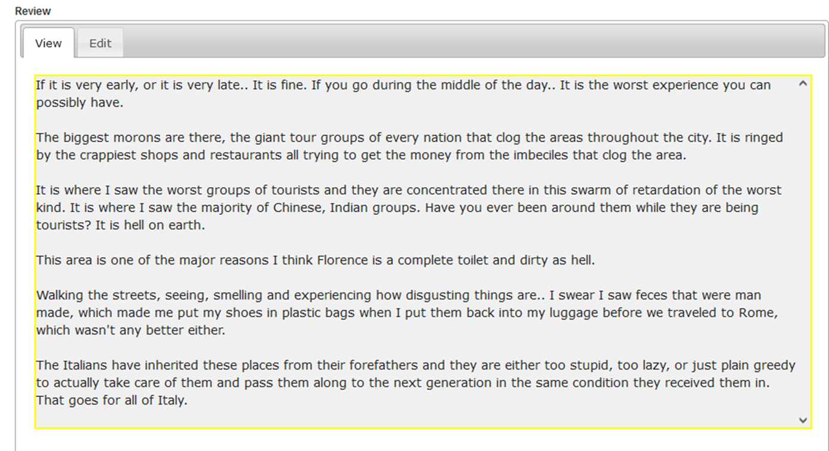
Discriminatory Language
Racist and prejudice comments.
Broad generalizations of a race, nationality, or orientation.
Revamped
Taking Action
10

Slide 12
Duplicate Reviews: Multiple Pending
Multiple pending Duplicate reviews
Read all reviews and publish the most substantive one. Remove any other with No Duplicate removal reason, send only one template. Unselect the ‘send template’ box on other submissions to de-activate additional emails to user. Include comment on each one that template was sent via reviewID#.
Revamped
Taking Action
11

Slide 13
Duplicate Reviews: Verification Pending
Verification is pending while a duplicate review comes in.
Consider the 2nd submission as a verification and publish the more substantive review. Remove the other without template.
Revamped
Taking Action
12

Slide 14
Duplicate Reviews: HOLD Status
One review is in a HOLD status while the other is pending.
Publish the pending submission and remove the first review (on HOLD) as a duplicate, without a template.
Revamped
Taking Action
13

Slide 15




Duplicate Reviews: Tips & Reminders
Escalation scenarios
All related duplicate reviews containing an escalation scenario should be escalated without action taken (publish/remove), per Escalation Path.
icon
Neither review published yet
Publish the more substantive one -- reviews with photos should be chosen if you have an option.
Duplicate template rule
The Duplicate template should not be sent if the same/similar content is not yet in a published status.
Taking Action
14

Slide 16
Experience > than 1 Year
The date or timeframe should be specified.
“I was here in 2015 and it was the best place for burgers…”
“We took our kids to Disney two years ago, we can't wait to go back…”
“I went several years ago and just drive by, I can't believe it is still open…”
Revamped
Taking Action
15
Notes:
Source: original slide 11 (Experience > than 1 year). All 3 verbatim examples preserved. Source also had a decorative picture with no clear content role on this template type (Type 8 has no illustration slot) -- not re-embedded; available on request.

Slide 17
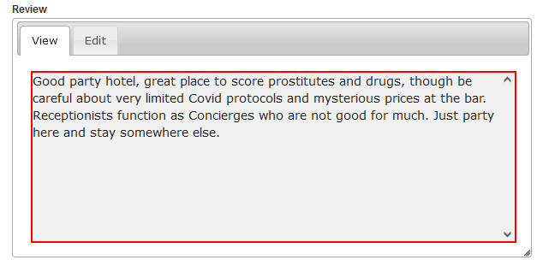
Illegal Activity
Participation in illegal activity, such as involvement in prostitution or illicit drug activities.
Tips in circumventing the law.
Revamped
Taking Action
16
Notes:
Source: original slide 12 (Illegal Activity). Original screenshot re-embedded.

Slide 18
Ineligible Experience
Ineligible experience covers:
Comments on media events; timeshare presentations; requests to use property bathroom without being a guest; unsuccessful attempts to contact a business prior to being a guest or having a reservation; long term stays involving landlord/tenant relationships.
Revamped
Taking Action
17
Notes:
Source: original slide 13 (Ineligible Experience). 5-item list (no verbatim quotes, category names only) folded into body copy verbatim.

Slide 19
Will Not List
Will Not List scenarios.
Geos, Airports, Liquor Stores, Strip Clubs, …and more.
Revamped
Taking Action
18
Notes:
Source: original slide 14 (Will Not List). Short list preserved verbatim.

Slide 20
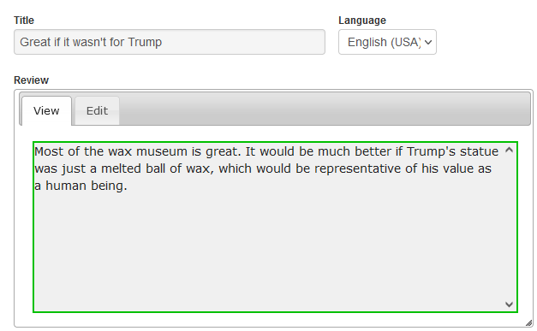
Irrelevant Commentary
Political, ethical, religious commentary
Revamped
Taking Action
19
Notes:
Source: original slide 15 (Irrelevant Commentary). Original screenshot re-embedded. 'Political!' callout preserved verbatim as the framing line.

Slide 21
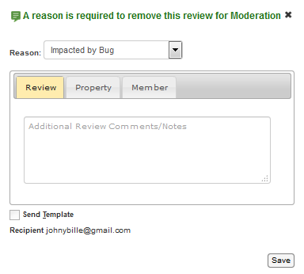
Impacted by Bug
For bugs and projects.
It should only be used when instructed to do so.
Revamped
Taking Action
20
Notes:
Source: original slide 16 (Impacted by Bug). Original screenshot re-embedded.

Slide 22
Irrelevant Commentary & COVID-19
Property Safety Measures
We will remove content that criticizes the way a business chooses to enforce safety policies related to the virus with this removal reason: select Irrelevant Commentary as Removal, deselect the user template, select save to remove the review, manually send ‘Covid-19 review rejection’.
Revamped
Taking Action
21
Notes:
Source: original slide 17 (Note on Irrelevant Commentary and COVID), process steps portion (1 of 2). Split from the verbatim example on the following slide.

Slide 23
COVID-19 Example
Example of a review to remove under this guidance:
“This Museum required masks and physical distancing even though we were the only visitors in the place. Totally ridiculous, I will not return”
Revamped
Taking Action
22
Notes:
Source: original slide 17 (Note on Irrelevant Commentary and COVID), verbatim example portion (2 of 2). Quote preserved exactly as written, including the repeated 'even even' typo.

Slide 24
Listing Update
For reports of closures or updates to a property.
The process to report closures and updates remains the same. Temporary closures should not be reported -- they can be removed with Ineligible Experience.
Revamped
Taking Action
23
Notes:
Source: original slide 18 (Listing Update).

Slide 25
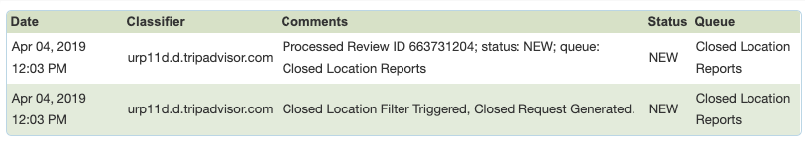
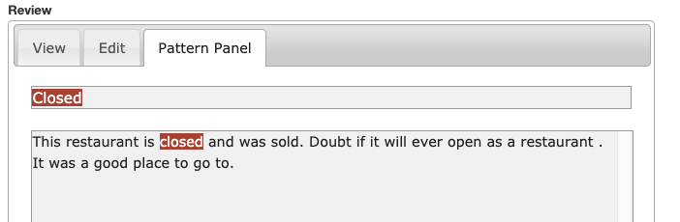
Closed Location Filter
Important note: if the Closed location filter has fired, it does not always mean the property should be marked as closed read the text to see if the user is reporting a closure.
Revamped
Taking Action
24
Notes:
Source: original slide 19 (Closed Location Filter). Source had 2 screenshots; primary one re-embedded, 2nd available on request.

Slide 26
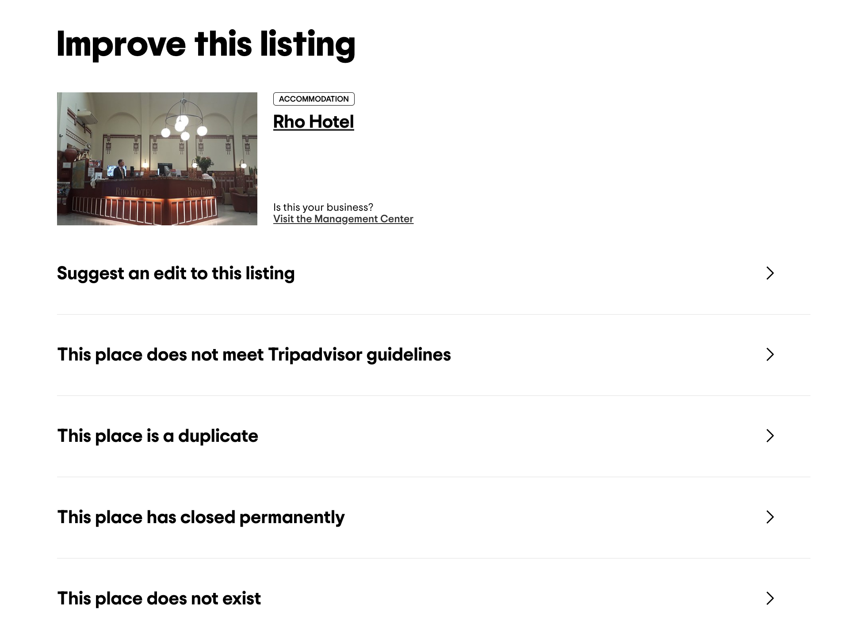
Reporting an Update
Reporting a Listing as Permanently Closed
Report via the “Improve this Listing” link on the live site. Temporary and Seasonal closures do not need to be reported. In addition to closures, any updates to the listing which are mentioned in the content being analyzed should be reported via the ITL button.
Revamped
Taking Action
25
Notes:
Source: original slide 20 (Reporting an Update). Screenshot re-embedded.

Slide 27
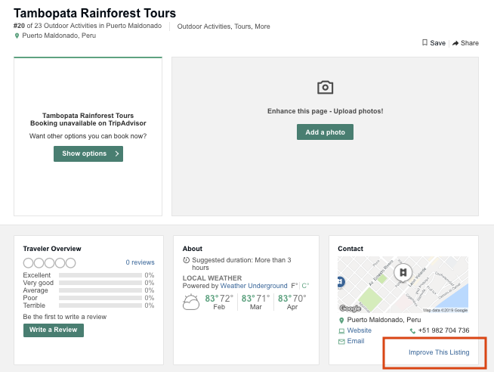
Reporting an Update on the Live Site
Improve This Listing Process
Due to ongoing testing, the link is not always found in the same place. Please look for the Improve this Listing link as described below and if not found, update via ART - Escalate to SF button.
Click on the live site via ART listing icon; check for ITL link as seen at right.
icon
Revamped
Taking Action
26
Notes:
Source: original slide 21. Screenshot re-embedded.

Slide 28
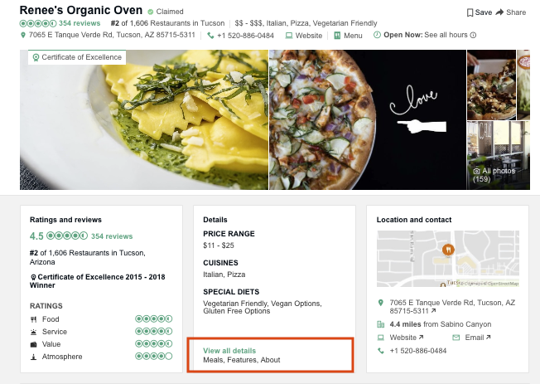
Improve This Listing Process (cont.)
If the ITL is not found on the initial page, click on “View all details” and check for ITL link in the pop up. If not found in either of those places, update via ART - Escalate to SF button.
Make sure to include a note that the ITL is not available.
icon
Revamped
Taking Action
27
Notes:
Source: original slide 22. Screenshot re-embedded.

Slide 29
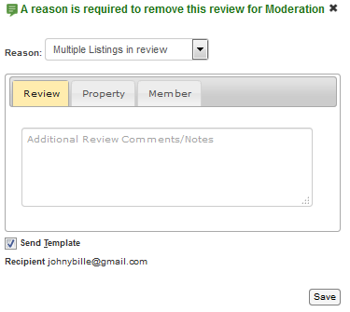
Multiple Listings
Used when a review is substantially about more than one property, that is unrelated to the attachment.
For example, the review is about two different restaurants. We publish reviews of hotels that also equally describe an experience with another property at the same location. This removal reason should generally never be used for all-inclusive properties.
Revamped
Taking Action
28

Slide 30
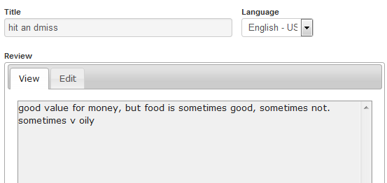
Not-substantive
Used when a review lacks detail or is not helpful.
When in doubt, lean on the side of publish. The title of a review should be considered when determining if a review is substantive. The tip and photos should not.
Revamped
Taking Action
29

Slide 31
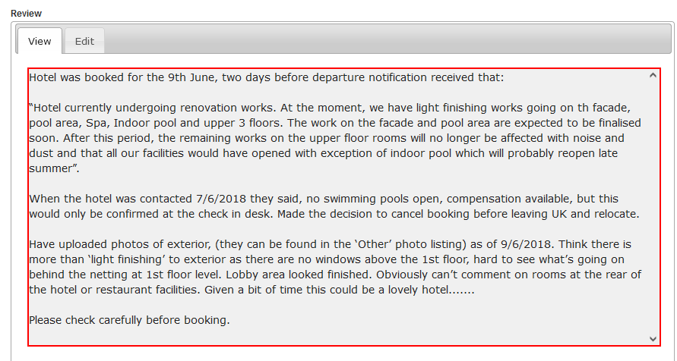
Non-Original
Copied content or
Correspondence
from others.
Revamped
Taking Action
30
Notes:
Source: original slide 25. Screenshot re-embedded.

Slide 32
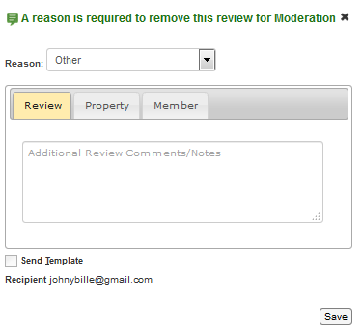
Other
Should only be used in instances where there is no other removal reason available.
Revamped
Taking Action
31
Notes:
Source: original slide 26 (Other). No screenshot in source.

Slide 33
Owner Support
Owner requests for assistance; owner responses submitted via the review form; announcements from owners that are not written as a guest review.
Owner Support: “Hey TA reviewers, we have new hours -- check out our website!”
Susp. or Confirmed Fraud: “This pizza place just opened on 9th block and they have the best pizza in Ny. Check them out!”
Revamped
Taking Action
32
Notes:
Source: original slide 27 (Owner Support). Both verbatim template examples preserved.

Slide 34
Personally Insulting (1 of 2)
Personal insults.
“The miserable old bag who owns this place…”
“was astonished at the sheer rudeness of one fat manager…”
“The owner lady is also bipolar…”
Revamped
Taking Action
33
Notes:
Source: original slide 28 (Personally Insulting), examples 1-3 of 5. Verbatim, including the source's own ableist/insulting language -- preserved exactly per no-rewording rule (these are the trainer's real examples of insults to catch).

Slide 35
Personally Insulting (2 of 2)
Personal insults (continued).
“The small midget looking man…”
“I didn't get her ugly face on camera…”
Revamped
Taking Action
34
Notes:
Source: original slide 28 (Personally Insulting), examples 4-5 of 5.

Slide 36
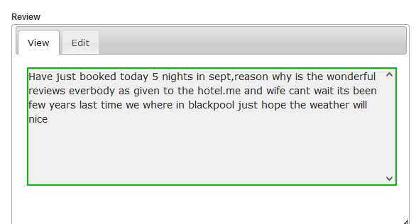
Pre-review
Reports of an upcoming trip.
Revamped
Taking Action
35
Notes:
Source: original slide 29. Screenshot re-embedded.

Slide 37

Private Info
Property private information, such as wifi codes or key locations.
A member's identity that is revealed in an OR that is not shared in their review or part of their username.
Revamped
Taking Action
36
Notes:
Source: original slide 30. Screenshot re-embedded.

Slide 38
Profane/Vulgar (1 of 2)
From the mouths of our reviewers...
“Not worth a wet wank on a winter's day”
“I would rather sh&t in my hands and clap”
Revamped
Taking Action
37
Notes:
Source: original slide 31 (Profane/Vulgar), examples 1-2 of 4. Verbatim, including profanity -- preserved per no-rewording rule (Part 5 precedent).

Slide 39
Profane/Vulgar (2 of 2)
From the mouths of our reviewers (continued)...
“Mind you, I'll eat a goat's ass if I'm hungry enough?”
“When he finally did arrive he was useless as tits on a bull”
Revamped
Taking Action
38
Notes:
Source: original slide 31 (Profane/Vulgar), examples 3-4 of 4.

Slide 40
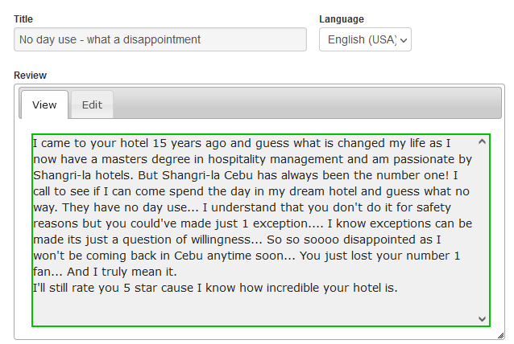
Property Policy Complaint
Comments on property policy as a
non-guest, without a valid service experience.
Revamped
Taking Action
39
Notes:
Source: original slide 32. Screenshot re-embedded.

Slide 41


Traveller2020
New York City, US
Rating Misunderstood
The place sucks! Do not recommend!
Inconsistency between text and selected rating
My pasta was frozen, the steak was raw, and we bad way too much for junk food. I’d never return
Revamped
Taking Action
40
Notes:
Source: original slide 33. 'Bubbles' callout preserved verbatim. Screenshot re-embedded.

Slide 42
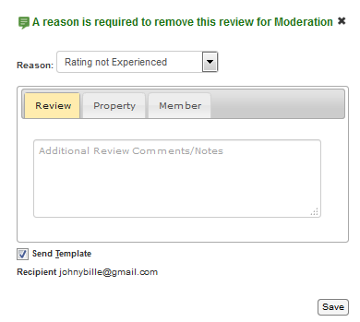
Rating Not Experienced
Used when a reviewer rates a sub-category that they haven't experienced.
It is okay to send when sub-categories are clearly rated incorrectly. For example, a positive review with a 4 or 5 rating and all amenities are rated a '1'. A user can always rate 'Value'. Attractions do not have ratings.
Revamped
Taking Action
41
Notes:
Source: original slide 34. Screenshot re-embedded.

Slide 43
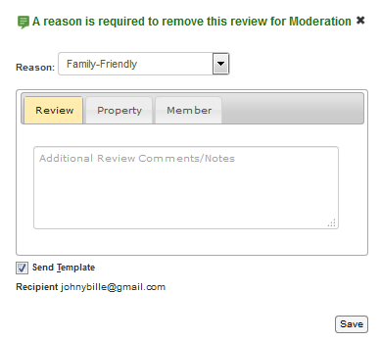
Sexually Explicit/Graphic
Used when a reviewer includes non-family friendly content, such as graphic descriptions of sexual activity.
Revamped
Taking Action
42
Notes:
Source: original slide 35.

Slide 44
Second Hand Experience
Used when a reviewer is reporting only on another traveler's experience.
“My daughter stayed at this hotel and loved it.”
“My son went to Disney World with his cousins. They spent 5 days going to the parks and of them all, Space Mountain was his favorite.”
Revamped
Taking Action
43
Notes:
Source: original slide 36 (Second Hand Experience). Both examples preserved verbatim.

Slide 45
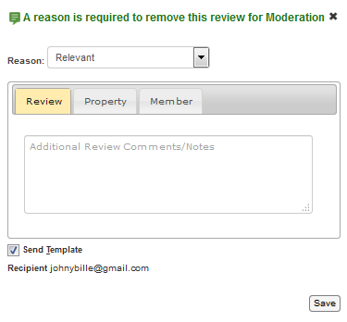
TA Commentary
Used when a reviewer has included excessive or inflammatory comments about other reviews, reviewers or owner responses.
Revamped
Taking Action
44
Notes:
Source: original slide 37.

Slide 46
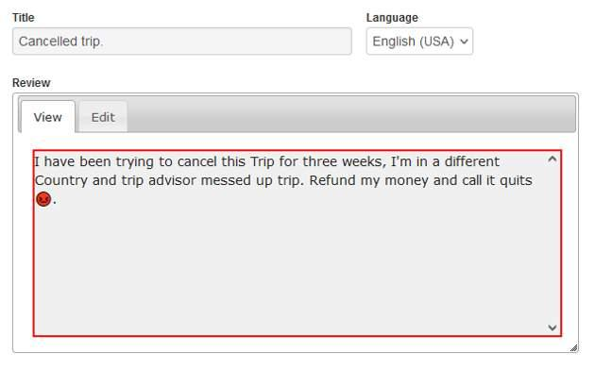
TA Booking (1 of 3)
Because we do not list online booking sites on Tripadvisor, we have to remove any review that focuses only on a booking experience with Tripadvisor or Viator. Normally, reviews for online booking sites are rejected with Will Not List, but when users are writing about our company services, we have created a more custom template that provides directions to reach out to Customer Service for possible resolution.
This review can be rejected because it focuses solely on the Tripadvisor booking experience.
Revamped
Taking Action
45
Notes:
Source: original slide 38 (TA Booking, part 1). Screenshot in source has no slot on this template type -- available on request.

Slide 47
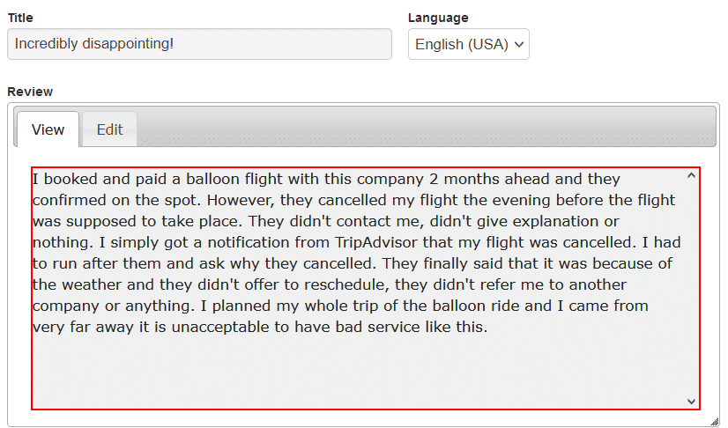
TA Booking (2 of 3)
Please note - it is not an automatic rejection if the user mentions Tripadvisor or Viator. If there is a direct experience or an expectation with the attached listing, and the commentary about TA is not excessive, the review can generally be published.
In this example, the user booked a ticket and has an expectation that the balloon tour will depart. A business cancelling a reservation without notice can be published.
Revamped
Taking Action
46
Notes:
Source: original slide 39 (TA Booking, part 2).

Slide 48
TA Booking (3 of 3) -- How to Process
A manual template is needed.
Remove using the Other removal reason, this is to ensure that no template is sent to user. Manually send the TA Booking reviewer template through the Reviewer Templates dropdown button.
Revamped
Taking Action
47
Notes:
Source: original slide 40 (TA Booking, part 3 -- How to Process).

Slide 49
User Support
Used when the reviewer is reporting an issue with the TA site or another review.
“TripAdvisor stop sending my newsletters!”
Revamped
Taking Action
48
Notes:
Source: original slide 41 (User Support).

Slide 50
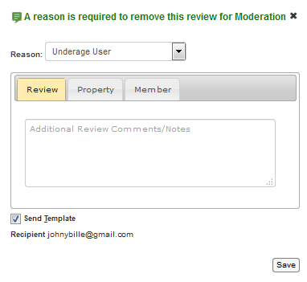
Underage User
We do not allow users under the age of 13.
If age is stated specifically in the text and is 12 or under, please use this removal.
Revamped
Taking Action
49
Notes:
Source: original slide 42.

Slide 51
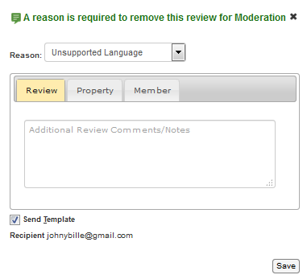
Unsupported Language
Used when a reviewer submits text in an unsupported language.
TripAdvisor currently accepts reviews in the following languages: Arabic, Chinese, Czech, Danish, Dutch, English, French, Finnish, German, Greek, Hebrew, Hungarian, Indonesian, Italian, Japanese, Korean, Norwegian, Polish, Serbian, Slovak, Portuguese, Russian, Spanish, Swedish, Thai, Turkish, Vietnamese.
Revamped
Taking Action
50
Notes:
Source: original slide 43. Full language list preserved verbatim.

Slide 52
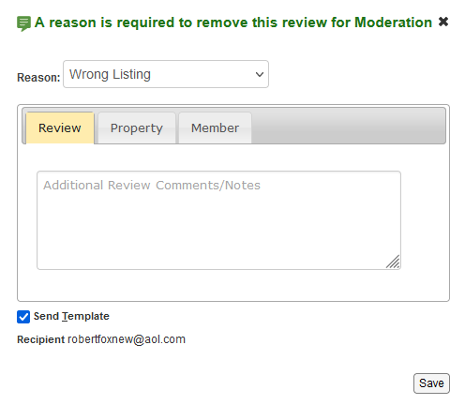
Wrong Listing
Used when the review is clearly attached to the wrong location and you are unsure which listing the review should be moved to.
Review is attached to hotel but is for a restaurant that is not named. Cannot determine the correct listing.
Revamped
Taking Action
51
Notes:
Source: original slide 44 (Wrong Listing). 2 screenshots in source; primary re-embedded.

Slide 53
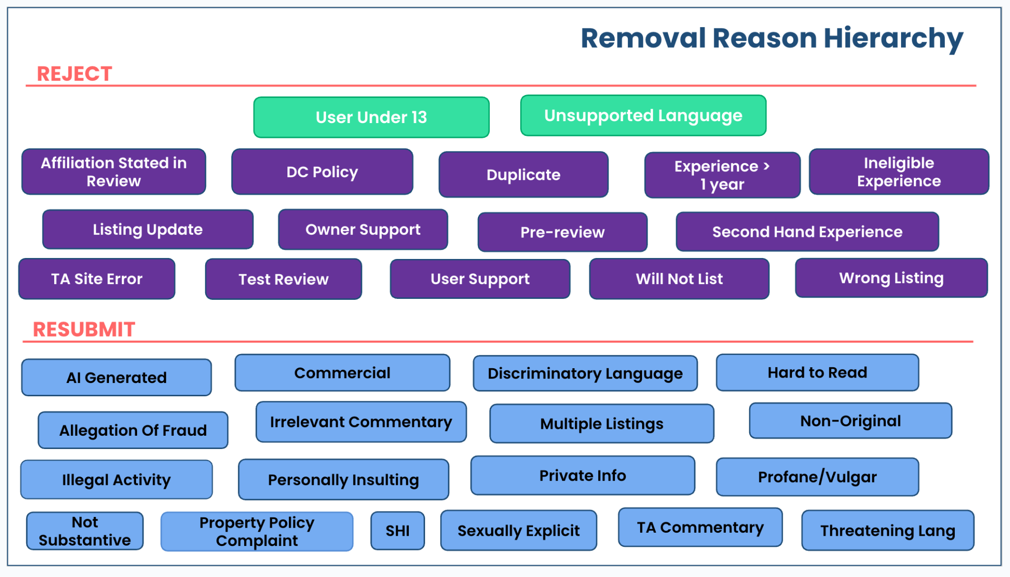
Removal Reason Hierarchy
Reject vs Resubmit
Revamped
Taking Action
52
Notes:
Source: original slides 45 (title/framing) + 46 (untitled diagram, no text of its own) combined onto one revamped slide -- slide 46 had no text content to stand alone on. Flag if you'd rather keep them as 2 separate slides.

Slide 54
Rejection Reason Hierarchy Notes (1 of 2)
icon
Rule 1
Check CI before taking a CM action -- fraud trumps mod.
Rule 2
Do not check attachment on reviews that do not meet guidelines. If correct attachment is clearly known, move to correct listing and use applicable removal reason.
Rule 3
If review needs to be escalated for New Listing but contains a guideline violation, remove with the guideline violation.
Taking Action
53
Notes:
Source: original slide 47 (Rejection Reason Hierarchy Notes), rules 1-3 of 6. Split into 2 slides rather than row-extending to 6 (overflowed the canvas on the first build attempt) -- all 6 rules preserved verbatim across both slides.

Slide 55
Rejection Reason Hierarchy Notes (2 of 2)
Rule 4
If there's a need to reject for Rating Not Experienced and another guideline such as Profanity, it's best practice to reject with Profanity or other applicable removal reason, as we hope the user will mend his/her error. Same for Rating Misunderstood.
Rule 5
If RMG and contains an Allegation of Incentives and/or Bullying, publish the review and manually send the applicable template.
Rule 6
If DMG, manually send the allegation template along with the appropriate removal reason.
Taking Action
54
Notes:
Source: original slide 47 (Rejection Reason Hierarchy Notes), rules 4-6 of 6.

Slide 56
Moderation Verifications
When to manually send verifications for mod reasons.
When a review from a new user mentions bedbugs or food poisoning, an automatic verification is sent once the 'publish' button is selected. The review will not be posted until the user responds and verifies the submission. We manually verify reviews that make certain serious accusations, such as: any theft, robbery or burglary alleged at the property or by a staff member; a food poisoning* or bed bug accusation that did not trigger the BedBug verification filter. *Illness due to food allergies does not need to be verified.
Revamped
Taking Action
55
Notes:
Source: original slide 48 (Moderation Verifications, part 1).

Slide 57

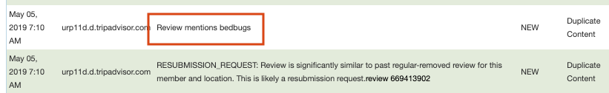
Moderation Verifications: BedBug Filter
Did the BedBug Verification Filter fire on the review?
If the filter did NOT fire on the review
Select Publish -- verification will automatically be sent.
Select Verify (not Publish). The review stays pending until the user verifies; it then auto-publishes or re-queues for review.
*BedBug verification filter status will be visible in the comment history on the ART
Revamped
Taking Action
56
Notes:
Source: original slide 49 (Moderation Verifications, part 2). Scenario/exception template type fits the filter-fired/not-fired branching. Original screenshot re-embedded into the template's illustration slot (id 15).

Slide 58
New User vs. Established User
Moderation Verifications should be sent manually ONLY for reviews from new users.
An established user means they have other reviews in their history that have been published days prior to the review with the allegation.
Revamped
Taking Action
57
Notes:
Source: original slide 50.

Slide 59
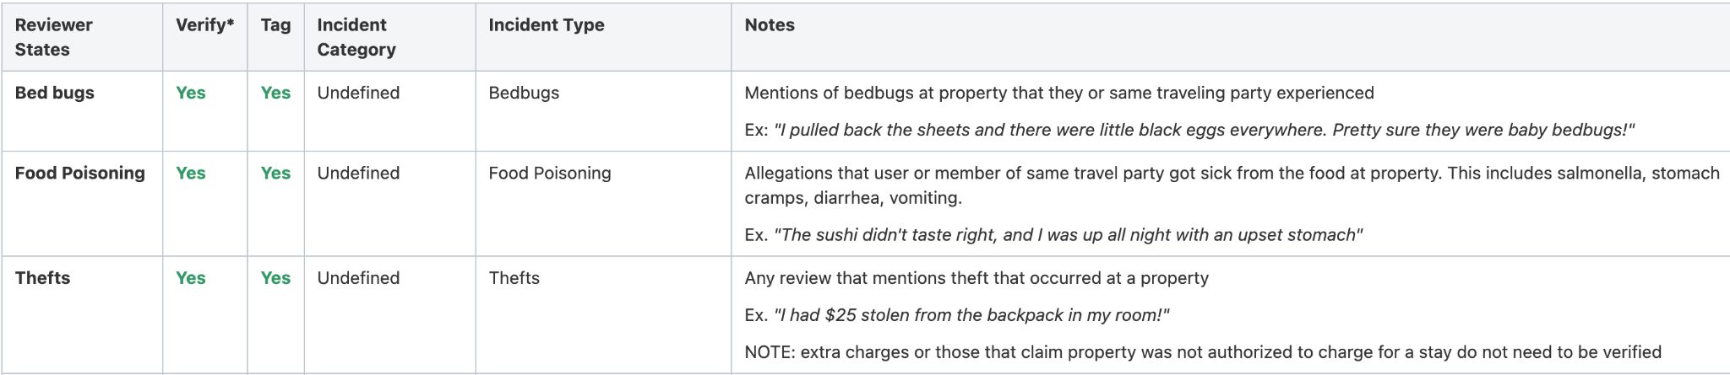
Verifications
The following references in review text would qualify for a verification to be issued to new users:
There is no need to verify for any of these scenarios if the user is established. For this purpose 'established' means they have other reviews in their history that have been published days prior to the review with the allegation.
Revamped
Taking Action
58
Notes:
Source: original slide 51.

Slide 60



5 min
Discussion: Moderation Removals
What questions come to mind?
Think about:
Which removal reasons still feel unclear to you?
Which scenarios would you want a second opinion on?
Share your questions with your group.
New
Taking Action
59
Notes:
Source: original slide 52 (What questions come to mind?), closing Moderation Removals. 'Think about' prompts are new framing text (discussion slides are net-new by convention) -- flag if you'd rather these come from you directly.

Slide 61
CHECK
??
Knowledge Check: Moderation Removals
"I used to work here" appears in a review. What removal reason applies?
A
Affiliation Stated in Review
✓
B
Not-substantive
C
Other
D
Ineligible Experience
New
Taking Action
60
Notes:
NEW slide -- knowledge check, no source original. Tests Affiliation Stated in Review (orig slide 4).

Slide 62
CHECK
??
Knowledge Check: Duplicate Reviews
One duplicate review is in HOLD status while the other is pending. What's the correct action?
A
Publish the pending submission, remove the HOLD one as duplicate, no template
✓
B
Remove both reviews with No Duplicate reason
C
Publish both reviews
D
Escalate to Fraud Support
New
Taking Action
61
Notes:
NEW slide -- knowledge check, no source original. Tests Duplicate Reviews HOLD Status scenario (orig slide 10).

Slide 63


Section 1 Recap: Moderation Removals
Key takeaways from the topics covered in this section
1
Regular removals cover the standard content-quality reasons -- from personal insults to non-substantive reviews -- while duplicate reviews get resolved by publishing the most substantive submission, not templating every one.
2
The Removal Reason Hierarchy exists because guideline violations and fraud outrank routine moderation -- always check CI before taking a moderation action.
3
Moderation verifications (like the BedBug filter) only need manual follow-up when the automatic filter doesn't fire as expected.
New
Taking Action

Slide 64


Rest Area!
New
Now that we have covered Moderation Removals, do you have any questions?

Slide 65
[PHOTO PLACEHOLDER]
Sheikh Zayed Grand Mosque, Abu Dhabi, UAE
Fun fact: can hold over 41,000 worshippers and features the
world's largest hand-knotted carpet in a single room.
Canva search: "Sheikh Zayed Grand Mosque interior"
AI prompt: Sheikh Zayed Grand Mosque Abu Dhabi, white marble, golden hour
02
New
Member Fraud Removals
Fraud committed for the member's own gain, distinct from property fraud.
1
2
3
4
5
Notes:
Source: original slide 53 (Member Fraud Removals). Section 2 of 6, dot bucket round(2/6*5)=2. Attraction self-selected: Sheikh Zayed Grand Mosque, UAE -- checked against used_assets_tracker.md, not previously used.

Slide 66
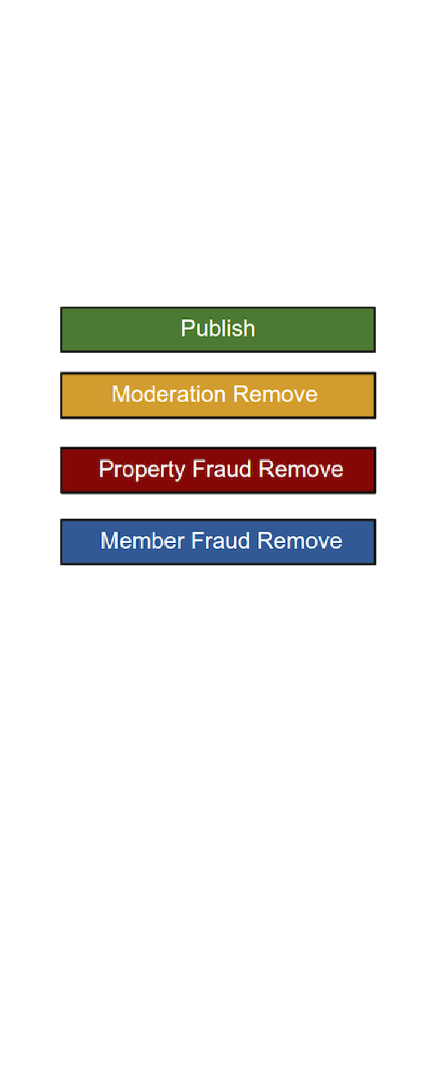
Member Fraud: The Basics
Member fraud falls under the category of “self gain” for the user, as opposed to property gain.
Revamped
Taking Action
62
Notes:
Source: original slide 54. Speaker notes from source preserved below. Original notes: It allows tracking of reviews without risking unintended punishment to the property. If not used properly, can lead to Inconsistent Classifier Scoring.

Slide 67
Employee Affiliate Reviews
Lower-ranking chain employee reviewing an affiliate property
Acceptable -- employees of hotel chains often receive discounts at affiliate properties, so lower-ranking employees may review affiliate properties in other geos.
Same-geo or suspected bias
Large chain employees can review other chain properties only if NOT in the same geo where they work, and no other bias is suspected (e.g. reviewer is also a family member of someone who works at the reviewed property).
Revamped
Taking Action
63
Notes:
Source: original slide 55 (Taking action). Original notes: 'Note: we can evaluate case by case and if a user is very established and doesn't seem to have any economic interest in the hotel, can decide to publish the review.' Source had 3 screenshots; primary re-embedded.

Slide 68
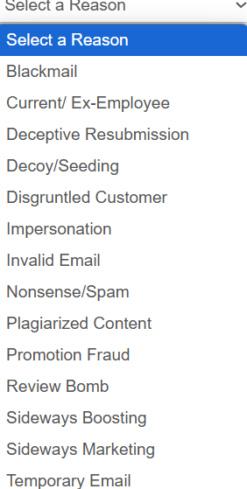
Types of Member Fraud
Blackmail, Promotion Fraud, Current/Ex-employee, Decoy/Seeding, Disgruntled Customer, Duplicate/Plagiarized Content, Nonsense/Spam/Test, Deceptive Resubmission, Impersonation, Invalid Email, Sideways Boosting, Sideways Marketing, Review Bomb, Temporary Email.
Revamped
Taking Action
64
Notes:
Source: original slide 56 (Types of Member Fraud). All 14 categories preserved verbatim as a list -- simple Type 6 list chosen over a journey-map repurposing; flag if you'd rather see this as a grid/index.

Slide 69
Member Fraud vs. Property and Moderation Removals
What happens if it is Member Fraud and you remove it as something else?
Property Fraud Remove
Moderation Remove
the count of suspicious reviews against the property is increased despite no owner involvement
The owner will be exonerated, BUT the attributes of the undesirable member behavior CANNOT be tracked.
Revamped
Taking Action
65
Notes:
Source: original slide 57.

Slide 70
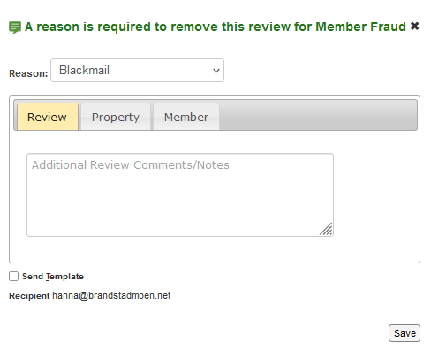
Blackmail
An attempt to use TA to obtain money/services/special treatment in exchange for not posting a negative review. For CMI, it is in the text of the review.
“If the owner refunds my money, I’ll remove this review.”
Revamped
Taking Action
66
Notes:
Source: original slide 58 (Blackmail). Original notes: guest asking for a refund in the review text is within publishable guidelines, but if the owner has proactively reported blackmail and the text has a refund request with good property karma, FPS decides the issue. Screenshot in source has no slot on this template type.

Slide 71
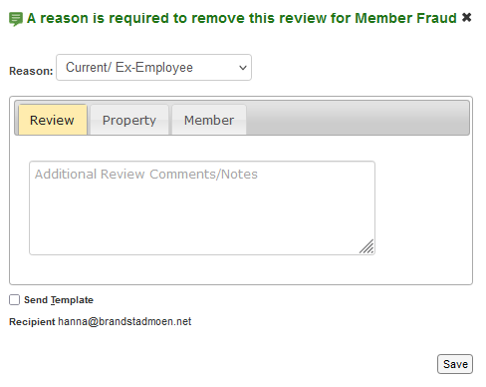
Current/Ex-Employee
To be used when evidence suggests the user is a current or ex-employee.
Do not use when the affiliation is mentioned in the text (AWP). For use only on negative reviews, otherwise it's likely boosting.
Revamped
Taking Action
67
Notes:
Source: original slide 59. Original notes: text disclosing current employment would be a moderation removal based on affiliation with property (confirmed vote/other review); automatically added to db.

Slide 72
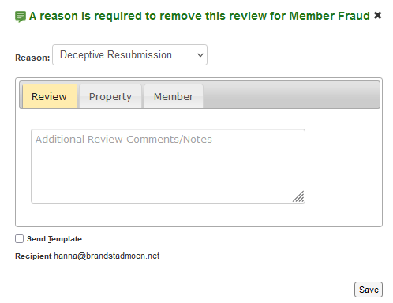
Deceptive Resubmission
To be used when a member edits the text and changes their story in order to meet guidelines.
Don't forget to open dupes in the history -- this is where you'll find that information.
Revamped
Taking Action
68
Notes:
Source: original slide 60. Original notes: a review where a member tries to re-submit content that doesn't meet guidelines by altering their text, e.g. claiming a stay 2 years ago, then resubmitting to say they stayed recently.

Slide 73
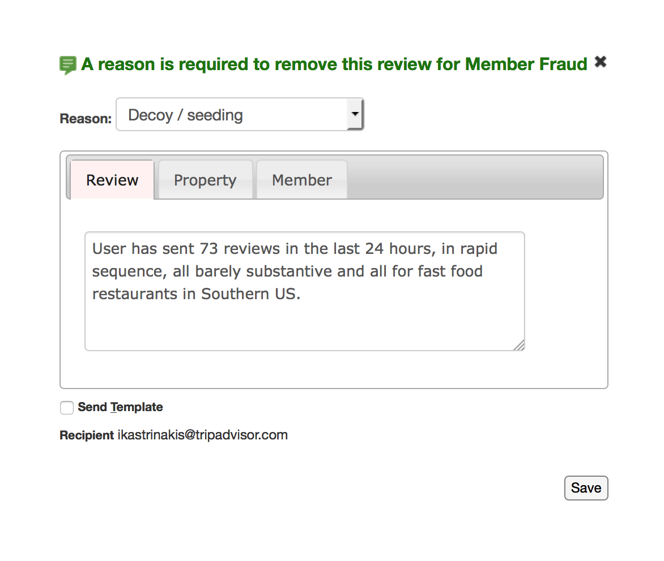
Decoy/Seeding
Reviews created to establish reviewer history/karma/credibility.
Remove only if non-substantive or blatantly abusive.
Revamped
Taking Action
69
Notes:
Source: original slide 61.

Slide 74
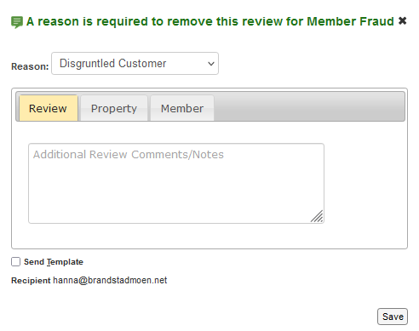
Disgruntled Customer
Used when a member resubmits multiple times based on the same experience, but the situation does not rise to the level of a smear campaign.
Equivalent to a member fraud removal, no template sent. PF assessment is required.
Revamped
Taking Action
70
Notes:
Source: original slide 62.

Slide 75
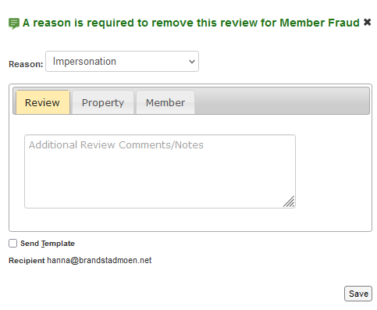
Impersonation
Used when a member is impersonating someone else, with a deliberate motive such as bringing prestige and credibility to their TA profile and reviews.
“I am Donald Trump and this is my favorite restaurant to go to…”
Revamped
Taking Action
71
Notes:
Source: original slide 63 (Impersonation). Screenshot in source has no slot on this template type.

Slide 76
Invalid Email
These are hard to detect but if spotted, can be removed. Examples of invalid/incomplete emails:
“@yaho.com”
“@gmai.com”
“@ao1.com”
Revamped
Taking Action
72
Notes:
Source: original slide 64 (Invalid Email). All 3 examples preserved verbatim. Screenshot in source has no slot on this template type.

Slide 77
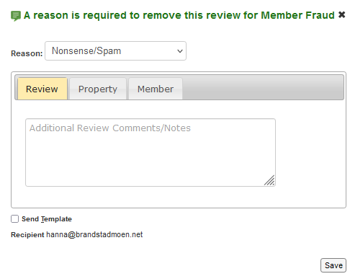
Nonsense/Spam
Used when a member submits joke reviews or is spamming the site.
Revamped
Taking Action
73
Notes:
Source: original slide 65.

Slide 78
Promotion Fraud
Currently, there aren't any Promotion Campaigns running or within the foreseeable future.
There should not be any reason to use this.
Revamped
Taking Action
74
Notes:
Source: original slide 66.

Slide 79
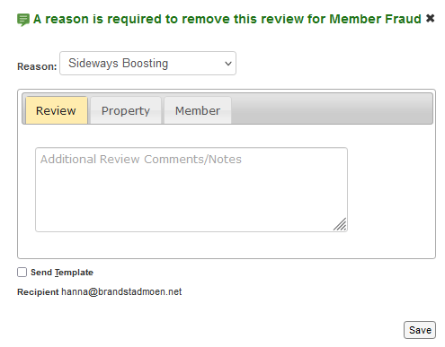
Sideways Boosting
Owners (or their affiliates) writing reviews for locations nearby, mentioning their property to entice guests to visit them.
Revamped
Taking Action
75
Notes:
Source: original slide 67.

Slide 80
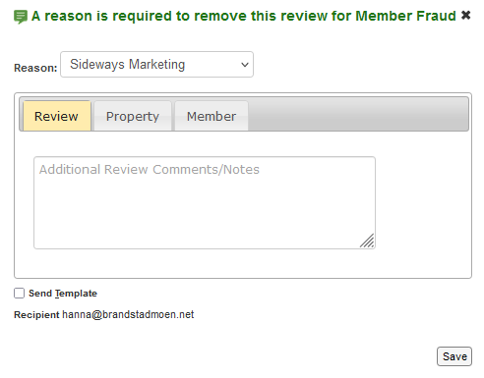
Sideways Marketing
A member is trying to promote their own business that does not qualify for a listing on our site. The text is usually the same and attached to several different listings.
“This restaurant has the best pizza. If you want to read more about my travels and purchase my book, visit www.paotravels.com”
Revamped
Taking Action
76
Notes:
Source: original slide 68 (Sideways Marketing). Screenshot in source has no slot on this template type.

Slide 81
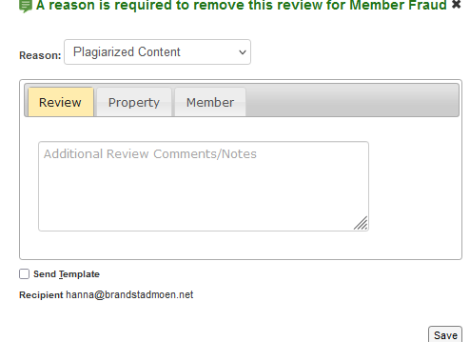
Plagiarized Content
To be used when users are copying other published reviews.
Lean towards Suspected Boosting if the review is positive and copied from a published review -- it is likely someone affiliated with the property.
Revamped
Taking Action
77
Notes:
Source: original slide 69. Original notes: if you copy text from another website or another review, the review should be MF removed regardless of whether they get a template.

Slide 82
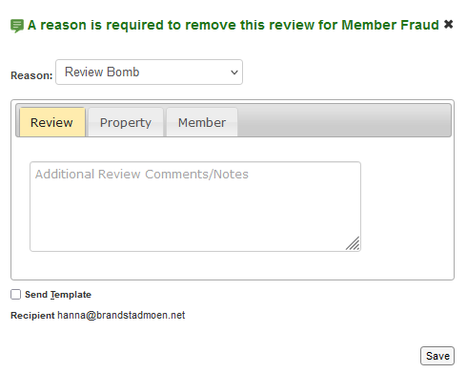

Review Bomb
This is mostly used for responses to a media event, such as the property being in the news.
It can also be used to remove reviews from guests who had a negative experience with the business and ask friends who did not stay to write negative reviews (there would be shared attributes, perhaps?).
Revamped
Taking Action
78
Notes:
Source: original slide 70 (Review Bomb). Original notes: in some cases, a 'Sensitive Rejection' template may be more appropriate -- discuss with a specialist or TL (e.g. a death in the family prompting a negative review from a relative). See wiki: smear-campaign-reporting-and-processing. Source had 4 screenshots; primary re-embedded.

Slide 83
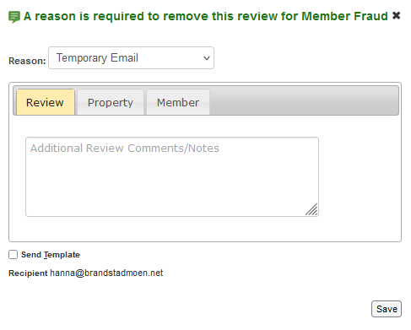
Temporary Email
Use if you recognize a temp email domain.
Revamped
Taking Action
79
Notes:
Source: original slide 71.

Slide 84
5 min
Discussion: Member Fraud Removals
What questions come to mind?
Think about:
Which member fraud types feel hardest to distinguish from property fraud?
When would you ask for a second opinion?
Share your questions with your group.
New
Taking Action
80
Notes:
NEW slide -- discussion, closes Member Fraud Removals section.

Slide 85
CHECK
??
Knowledge Check: Member Fraud
A review says: “If the owner refunds my money, I’ll remove this review.” What removal type applies?
A
Blackmail
✓
B
Disgruntled Customer
C
Review Bomb
D
Owner Bullying Member
New
Taking Action
81
Notes:
NEW slide -- knowledge check, no source original. Tests Blackmail (orig slide 58).

Slide 86
CHECK
??
Knowledge Check: Types of Member Fraud
A member creates several throwaway accounts to post glowing reviews, building up credibility before submitting a real review from one of them. Which member fraud type is this?
A
Decoy/Seeding
✓
B
Sideways Boosting
C
Impersonation
D
Promotion Fraud
New
Taking Action

Slide 87
Section 2 Recap: Member Fraud Removals
Key takeaways from the topics covered in this section
1
Member fraud covers actions taken for the member's own gain -- separate from property fraud -- including blackmail, decoy/seeding, and sideways boosting or marketing.
2
Peripheral fraud detection means checking a member's broader history and connected accounts, not just the review in front of you.
3
Upgrading or downgrading a removal changes its severity based on new evidence -- always document
the reason for the change.
New
Taking Action

Slide 88
Fuel Stop!
New
Now that we have covered Member Fraud, do you have any questions?

Slide 89
[PHOTO PLACEHOLDER]
Plitvice Lakes, Croatia
Fun fact: the 16 terraced lakes are connected by waterfalls and
linked by wooden footbridges and walking trails.
Canva search: "Plitvice Lakes Croatia"
AI prompt: Plitvice Lakes Croatia, turquoise terraced waterfalls, forest, daylight
03
New
Property Fraud Removals
Fraud committed for the property's gain, including boosting, vandalism, and incentivized reviews.
1
2
3
4
5
Notes:
Source: original slide 72 (Property Fraud Removals). Section 3 of 6, dot bucket round(3/6*5)=3. Attraction self-selected: Plitvice Lakes, Croatia -- checked against used_assets_tracker.md and this session's prior picks (Halong Bay, Sheikh Zayed Grand Mosque), not previously used.

Slide 90

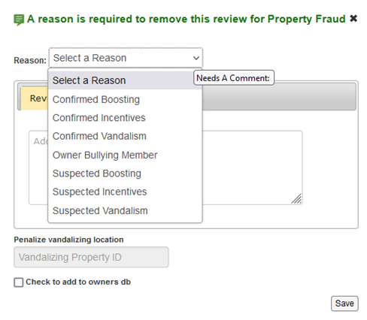
Property Fraud Removals
Peripheral Fraud assessment is required before submitting a property fraud removal.
Reviewers do not get a template to fill in for property fraud removals.
Peripheral Fraud assessment is required for all circumstances: which means all reviews associated with the user or the property should be evaluated
Revamped
Taking Action
72
Notes:
Source: original slide 73. Source had 2 screenshots; primary re-embedded.

Slide 91
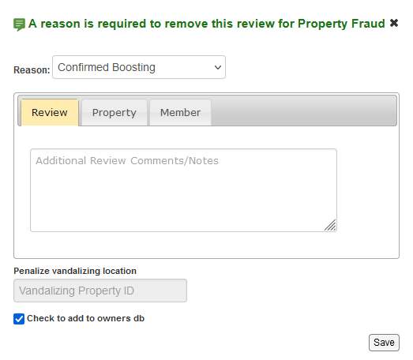
Confirmed Boosting
Used to remove a review and penalize the property when boosting is confirmed.
Used to remove review when an employee or affiliate of property writes a positive, fake review
Affiliation must be confirmed with evidence
Provide evidence in comment box
Vandalism box is greyed out, not used for boosting
Check to add to owner DB is auto-selected
Revamped
Taking Action
73
Notes:
Source: original slide 74 (Confirmed Boosting). Source had 2 screenshots; primary re-embedded.

Slide 92
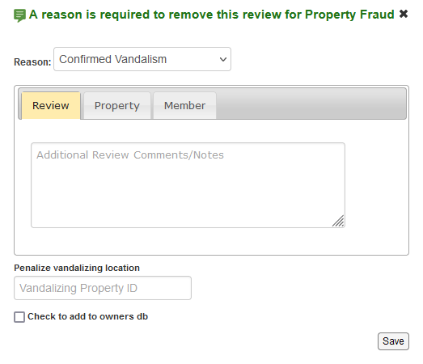
Confirmed Vandalism
Used to remove a review and penalize the property when vandalism is confirmed.
Important: Add the Property ID in the removal notes.
Revamped
Taking Action
74
Notes:
Source: original slide 75 (Confirmed Vandalism). Original notes include an "Add Property ID" instruction, preserved in the body text.

Slide 93
Confirmed Incentives
Used to remove a review and penalize the property when the property is confirmed to have offered an incentive in exchange for a review. Employee Incentives example:
“Barbie, one of our staff members, told us she'd get a bonus if we left a good review, so here it is!”
Revamped
Taking Action
75
Notes:
Source: original slide 76 (Confirmed Incentives). Original notes: NOTE -- we publish allegations of incentivized reviews in the review text itself; the removal applies to the confirmed incentive case. Source had 1 screenshot; no slot on this template type.

Slide 94
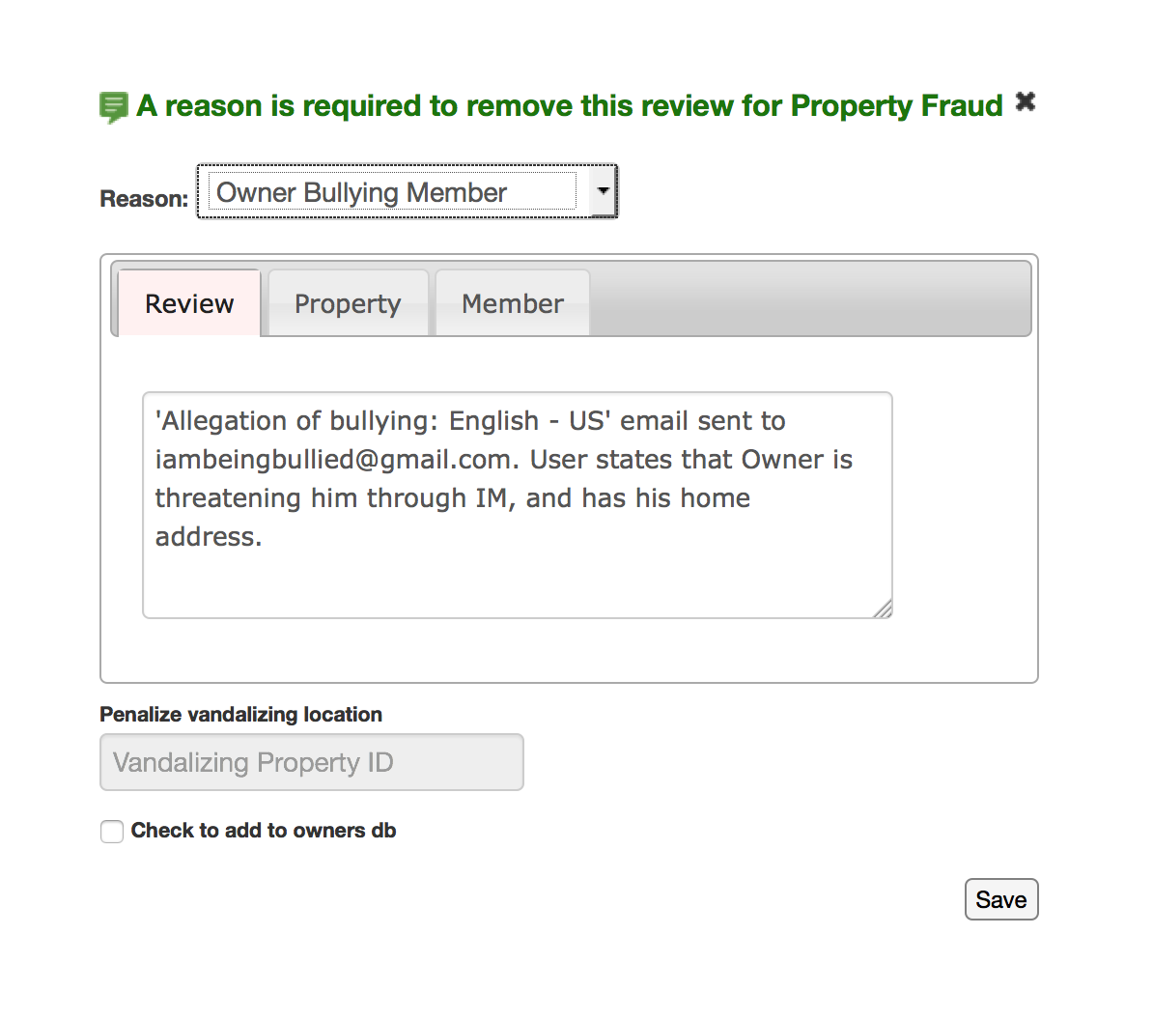
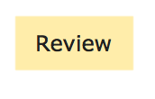

Owner Bullying Member
Used to remove reviews when an owner is bullying, harassing, or threatening a member over a review.
“Negative review removed because the owner is bullying the member in the property response, threatening legal action and demanding the member's personal information be handed over before they will stop.”
Revamped
Taking Action
76
Notes:
Source: original slide 77 (Owner Bullying Member). Example paraphrased from a longer source text block that mixed the removal rule with an illustrative scenario; flag if you'd rather see the original scenario text verbatim in speaker notes as well.

Slide 95
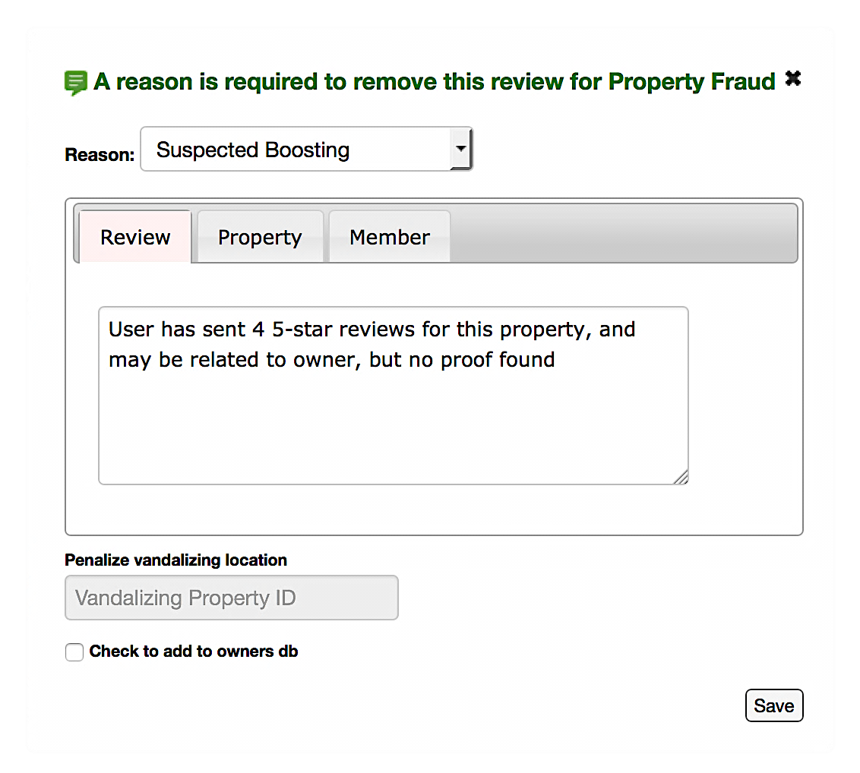
Suspected Boosting
Used when it is believed, but not confirmed, that a property is engaging in boosting.
Used when it is believed the owner or employees have written a positive review for their business
We cannot find a evidence direct match that links the user to the owner or an affiliate.
There is an element of suspicion, such as OTT text, overlapping attributes or suspicious email
Revamped
Taking Action
77
Notes:
Source: original slide 78 (Suspected Boosting).

Slide 96
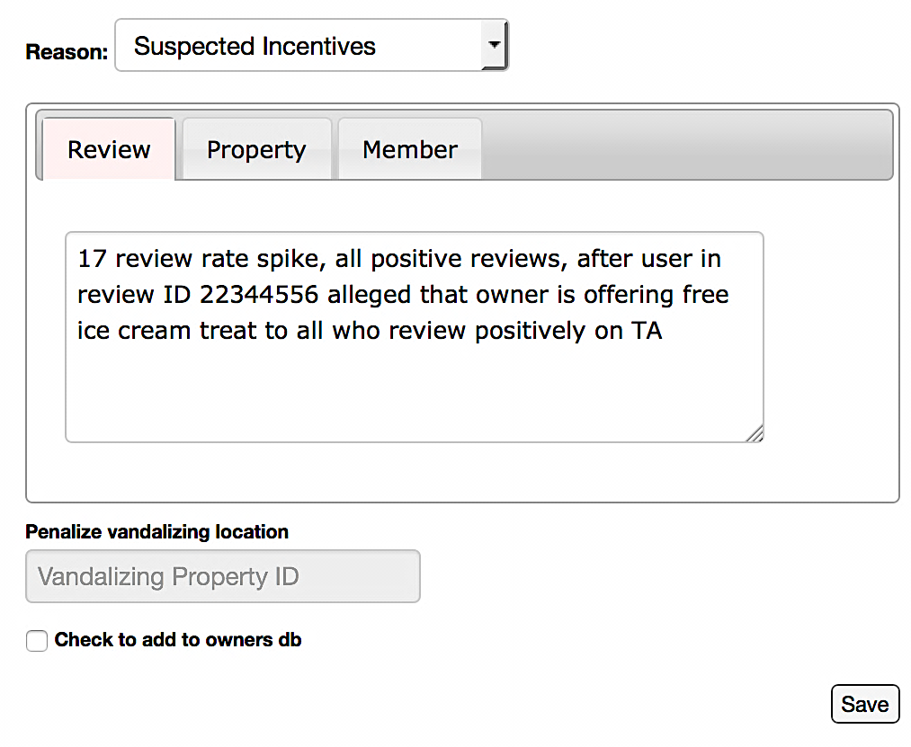
Suspected Incentives
Used to remove a review when we suspect, but cannot confirm, that the property offered an incentive in exchange for a review.
Used to remove review when we suspect incentives are being offered due to a rate spike, information on CI research, etc.
There should be matching elements to other reviews, such as email similarities, short reviews without a lot of substance, similar patterns in text or emojis
Revamped
Taking Action
78
Notes:
Source: original slide 79 (Suspected Incentives).

Slide 97

Suspected Vandalism
Used to remove a negative review when vandalism is suspected but not confirmed.
Often vandalism by one property is combined with attempts of boosting or other attempts of vandalism.
Revamped
Taking Action
79
Notes:
Source: original slide 80 (Suspected Vandalism).

Slide 98

Confirmed Vandalism & Boosting Removals
1. We have evidence that the review was submitted by an owner or a user affiliated to the property. 2. A similarly rated review is submitted and there is an owner password match in the history for the same property 3. A user’s name (contained in email, username, FB, member tool, or found online) matches the owner or affiliate’s name, …and/plus…
4. Please fill in Vandalism boxes when required
5. Any evidence found must be entered into the comment box
Revamped
Taking Action
80
Notes:
Source: original slide 81 (Confirmed Vandalism & Boosting Removals).

Slide 99


Slide 100
New
Peripheral Fraud Detection
Using a member's history and peripheral actions to detect fraud.
1
2
3
4
5
Notes:
Source: original slides 82/83 ("The history" / "Peripheral Actions", orig 83 was blank). Sub-divider within Property Fraud Removals -- keeps the parent section's dot state (03/3) per v8 sub-divider convention rather than introducing a new section number. v1 QA caught the template's default big "01" number (shape id 3) surviving untouched on this slide type -- removed it since a sub-divider isn't a new top-level section; first Type 5 sub-divider built this session, flagging this fix for reuse on future sub-dividers.

Slide 101
Peripheral Fraud Detection
Reviewing the user's history can reveal fraud that is not visible in the review text alone.
“Peripheral” refers to reviews and actions possibly related to, but outside of, the review under direct assessment.
Revamped
Taking Action
81
Notes:
Source: original slide 84.

Slide 102
Finding Fraud in Reviews
It's important to look at other reviews by the same member, and other reviews for the same property, not just the review being assessed.
It’s important to look at other reviews that may be connected to the one being processed.
Peripheral fraud can be found:
On member history (direct competitors, review promotion fraud)
On same attributes (FP,FGP,PW, IP..)
On the same property
Filters such as rate spike and similar email
Revamped
Taking Action
82
Notes:
Source: original slide 85. Bulleted list in source condensed into the body statement; flag if you'd rather see this split into its own bulleted layout.

Slide 103
Where to Look for Peripheral Fraud (1 of 2)
Does this member have any reviews with similar text patterns?
icon
Does this member have reviews across many properties in a short time span?
Does this property have other reviews from members with suspicious history?
Taking Action
83
Notes:
Source: original slide 86 (Where to look for Peripheral Fraud), items 1-3 of 5. Split 3+2 across Type 12's native 4 rows (row 4 dropped on this slide, all unused) rather than row-extending past 4 -- Chunk 4 found row-extension past the native 4 rows overflows the canvas (see 'Rejection Reason Hierarchy Notes' fix). Rows 2-3 use blank rule-number labels since these are checklist questions, not numbered rules.

Slide 104
Where to Look for Peripheral Fraud (2 of 2)
Does this member have reviews for properties owned or managed by the same person?
icon
Does this member's device or contact info match other flagged accounts?
Taking Action
84
Notes:
Source: original slide 86 (Where to look for Peripheral Fraud), items 4-5 of 5. Rows 3 and 4 removed (only 2 of 5 items land on this half).

Slide 105
Actions on Peripheral Fraud/Content
If you find additional fraud or fraudulent content while reviewing a member's history, take action on it too, not just the review under assessment.
Example: while investigating a boosting allegation, you find the same member left near-identical text on three other properties -- all three should be assessed and actioned.
Revamped
Taking Action
85
Notes:
Source: original slide 87 (Actions on Peripheral Fraud/Content).

Slide 106
Device Matches
Device (full cookie or partial cookie) matches can indicate related accounts.
If you see additional members sharing a device with the reviewer, investigate whether those accounts are also involved in the fraud.
Revamped
Taking Action
86
Notes:
Source: original slide 88 (Device). Decorative "=" shape in source (visual equivalence marker between the device text and the guidance text) not carried over -- meaning preserved in prose instead.

Slide 107
Password Matches
Two accounts with different emails share the exact same password.
If you see a password match between accounts, treat this the same as a device match when investigating peripheral fraud.
Revamped
Taking Action
87
Notes:
Source: original slide 89 (Example / password match).

Slide 108
When to Escalate: Peripheral Fraud
Agents are responsible for assessing peripheral fraud up to a certain scale.
When the scale of connected fraudulent accounts/reviews exceeds what a single agent can reasonably assess and action, escalate rather than continuing to investigate solo.
Revamped
Taking Action
88
Notes:
Source: original slide 90. NOT mapped to Type 13 (Escalation!) despite the "escalate" language: inspected Type 13's real template shapes this chunk and confirmed it's a fixed 'topic must ALWAYS be escalated' trigger-quote card (verbatim phrase examples + ESCALATE IMMEDIATELY badge) -- a format built for Section 5's escalation topics, not this general workload-threshold guidance. Used Type 6 instead as the safer fit; flag if you'd rather see this folded into Section 5 later instead of staying here.

Slide 109
Correcting Status from Peripheral Research
During your peripheral research, you may find that a previous action taken on a review was incorrect.
For example, the system made an error, or a prior agent missed evidence that is now visible in the member's broader history.
Revamped
Taking Action
89
Notes:
Source: original slide 91.

Slide 110
Changing a Review's Status
Please do not change the status of a review unless you have a specific reason to -- with one exception.
The one exception is covered on the following slides (upgrading and downgrading a removal).
Revamped
Taking Action
90
Notes:
Source: original slide 92 (transition line into orig 93-94).

Slide 111
Upgrading a Removal
You may upgrade a previous removal if you find evidence that justifies a more serious removal reason.
To upgrade a removal means to change its reason to a more severe fraud/moderation category than the one originally applied.
Revamped
Taking Action
91
Notes:
Source: original slide 93 (Upgrade).

Slide 112
Downgrading a Removal
Downgrade means to lessen the severity of a removal reason.
If a review was previously fraud-removed but you find the fraud does not hold up under closer review, downgrade it to the appropriate, less severe reason.
Revamped
Taking Action
92
Notes:
Source: original slide 94 (Downgrade). Simplified from a two-text-block source layout into a single Type 6 framing/body pair for consistency and to avoid the Type 7 illustration-slot risk seen elsewhere in this deck; flag if a scenario-style Type 7 slide is preferred here instead.

Slide 113


Slide 114
5 min
Discussion: Property Fraud Removals
What questions come to mind?
Think about:
How do you tell confirmed vs. suspected boosting apart in practice?
What peripheral-fraud signals would make you escalate rather than action solo?
Share your questions with your group.
New
Taking Action
93
Notes:
NEW slide -- discussion, closes Property Fraud Removals section (orig 96, "Questions?", expanded into a structured discussion slide).

Slide 115
CHECK
??
Knowledge Check: Property Fraud
A property is confirmed to be both vandalizing and boosting reviews. What should you do?
A
Fill in only the Vandalism removal notes box
B
Fill in only the Boosting removal notes box
C
Fill in both the Vandalism and Boosting removal notes boxes
✓
D
Escalate immediately without filling in either box
New
Taking Action
94
Notes:
NEW slide -- knowledge check, no source original. Tests Confirmed Vandalism & Boosting Removals (orig slide 81).

Slide 116
CHECK
??
Knowledge Check: Peripheral Fraud
While investigating a boosting allegation, you find the same member left near-identical text on three other properties. What should you do?
A
Ignore the other properties -- only assess the review you were assigned
B
Assess and action all three additional properties too
✓
C
Automatically escalate without further review
D
Wait for the member to submit another review before acting
New
Taking Action
95
Notes:
NEW slide -- knowledge check, no source original. Tests Actions on Peripheral Fraud/Content (orig slide 87).

Slide 117
Section 3 Recap: Property Fraud Removals
Key takeaways from the topics covered in this section
1
Property fraud removals -- boosting, vandalism, and incentivized reviews -- always require a Peripheral Fraud assessment and a completed removal-notes box before submitting.
2
Confirmed cases get the property penalized; suspected cases still get removed, but without penalizing the property until confirmed.
3
Look for patterns across a property's other reviews -- similar attributes, rate spikes, or matching devices -- before deciding confirmed vs. suspected.
New
Taking Action

Slide 118
Trailhead!
New
Now that we have covered Property Fraud, do you have any questions?

Slide 119
[PHOTO PLACEHOLDER]
Chefchaouen, Morocco
Fun fact: known as the "Blue City" for its blue-washed buildings,
a tradition said to date back to Jewish refugees in the 1930s.
Canva search: "Chefchaouen blue city Morocco"
AI prompt: Chefchaouen Morocco, blue-washed alley, daylight, travel photography
04
New
Incoming Reviews: Attachment Checks
Making sure reviews are attached to the correct property, restaurant, or attraction.
1
2
3
4
5
Notes:
Source: original slide 97 (Incoming Reviews / Attachment Checks). Section 4 of 6, dot bucket round(4/6*5)=3 -- capped at 3 since round(4/6*5)=round(3.33)=3, same as Section 3's dot state (5 dots cover 6 sections, some buckets repeat by design). Attraction self-selected: Chefchaouen, Morocco -- checked against used_assets_tracker.md and this session's prior picks, not previously used.

Slide 120

Incoming Reviews
Users select the location of the property they wish to review by searching on Tripadvisor.com.
A search for the ‘Marriott’ in Miami Beach results in 6+ similarly named properties -- mistakes happen and reviews occasionally get posted to the wrong listing.
Revamped
Taking Action
97
Notes:
Source: original slide 98.

Slide 121
Spotting a Mis-Attached Review
While processing a review, you may see an inconsistency between the review text and the subject/attachment. For example:
“The review is attached to a hotel but is reviewing a restaurant”
“The text mentions a geo in Europe but the accommodation is in the US”
“A visit to a spa is reviewed yet the attachment is for a hotel”
Revamped
Taking Action
98
Notes:
Source: original slide 99. All 3 example inconsistencies preserved verbatim.

Slide 122

Clear Reattachment
If it is clear where the review should be attached, there is no need to send an Attachment Check.
Simply move to the correct location by clicking the ‘Change Attachment’ button and searching for the property in the database.
Revamped
Taking Action
99
Notes:
Source: original slide 100.

Slide 123

Attachment Check Process: Sending
If it is believed the user has made an error with the review placement and you are not able to determine the correct location, you should send an ‘Attachment Check’ email.
To do so, click the ‘Check Attachment’ button located with the verification actions.
Revamped
Taking Action
100
Notes:
Source: original slide 101. Original had a "CLICK" callout pointing at the button in the screenshot -- not reproducible on this template type without hand-placed annotation geometry; instruction preserved in the body text instead.

Slide 124

Attachment Check Process: Pending
The review then enters the ‘Attachment Check’ queue in pending status, while waiting for the user to respond.
Revamped
Taking Action
101
Notes:
Source: original slide 102.

Slide 125

Attachment Check Process: 48-Hour Window
The user has 48 hours to respond to the ‘Attachment Check’ email.
Revamped
Taking Action
102
Notes:
Source: original slide 103.

Slide 126

Attachment Check Process: User Response
By clicking the link in the email, the user can confirm the attachment is correct or search for another property.
Revamped
Taking Action
103
Notes:
Source: original slide 104.

Slide 127
Attachment Check Process: Resolution
No further action is needed once the user responds -- the review automatically posts to the selected location.
If the reviewer does not respond to the Attachment Check email within 48 hours, the review is automatically removed. A second submission after the expiration will confirm the attachment.
Revamped
Taking Action
104
Notes:
Source: original slide 105.

Slide 128
Tips for Attachment Checks (1 of 2)
Text must meet guidelines. If not, remove with the appropriate guideline removal.
icon
Check for duplicates
Be sure to scroll down to User Review History to make sure there are not any published duplicates.
Resubmission is common
Users will often resubmit to the correct location once realizing their error.
Multi-listing submissions
Occasionally, users will submit the same review to all of a property's listings.
Taking Action
105
Notes:
Source: original slide 106 (Tips for Attachment Checks), tips 1-4 of 7. Split into 2 slides across Type 12's native 4 rows.

Slide 129
Tips for Attachment Checks (2 of 2)
For restaurant reviews attached to hotels: if there is only one eatery on site, do not send an AC -- simply reattach, or send the ‘New Listing’ template if no TA listing is found.
icon
Document your action
Leave a note that describes the action taken.
Cite your sources
Include relevant website or information that helped with the decision.
Taking Action
106
Notes:
Source: original slide 106 (Tips for Attachment Checks), tips 5-7 of 7. Row 4 removed (only 3 of 7 tips land on this half).

Slide 130
When to Use Wrong Listing
Review is clearly mis-attached -- when you know 100% that the review is not attached correctly but do not know the correct attachment.
For example, the review is for a tour and is attached to a hotel. Remove the review with the Wrong Listing removal reason so it moves to a ‘removed’ status.
Revamped
Taking Action
107
Notes:
Source: original slide 107. Original notes cite two real examples: review 230480075 (“lovely boutique hotel” text attached to a restaurant listing), and an owner voting a review attached to their hotel while the review discusses a restaurant on-site.

Slide 131
Why Not Use AC When Review is Clearly Mis-Attached?
We do not want to leave a review pending that is clearly incorrectly attached.
Sending an AC gives the member the option to verify that the attachment is correct when it is not, and may end up back on the wrong listing.
Revamped
Taking Action
108
Notes:
Source: original slide 108.

Slide 132
Template to User: Wrong Listing Removal (1 of 2)
Dear TripAdvisor Member,
Thank you for writing reviews on TripAdvisor. We are requesting that you resubmit your review of @@SUBJECT@@ because we believe it was submitted to the wrong listing on our site: you may have described aspects of the business that may not exist; the review may be about a different kind of business (e.g., a restaurant review posted to a hotel page); the listing itself may not meet TripAdvisor’s listing guidelines.
Revamped
Taking Action
109
Notes:
Source: original slide 109 (Template to User, sent when using Wrong Listing Removal), part 1 of 2 -- greeting and reason list, preserved verbatim including the @@SUBJECT@@ merge field and the three bulleted reasons. Split across 2 slides -- the full template did not fit legibly in one Type 6 body box.

Slide 133
Template to User: Wrong Listing Removal (2 of 2)
We value your contributions and if you’d be willing to resubmit your review to the correct location, we’d really appreciate it, and so will your fellow travelers! If the location you are trying to review is not on TripAdvisor, you can request to add it when you submit your review by clicking the ‘Tell us more about it’ link. Your original review is included below so you can easily copy and paste it into the review form. Please follow this link to submit your review: https://www.tripadvisor.com/UserReview. Thank you for your help.
Revamped
Taking Action
110
Notes:
Source: original slide 109, part 2 of 2 -- closing paragraph and submission link, preserved verbatim.

Slide 134
Same or Similarly Named Properties
Is the property in the database? Check whether you can reattach based on the review text (i.e. is the property name/geo/street mentioned?).
icon
If YES, reattach
Reattach & Publish -- after reattaching, check reviewer history for duplicate reviews.
If NO, cannot reattach from text
Send Attachment Check.
If the property is NOT in the database
Escalate for the listing to be added, or if cross-skilled, add the property and process.
Taking Action
111
Notes:
Source: original slide 110 (flowchart, "Same or Similarly Named Properties (brand/geo confusion)"). No template type matches a branching flowchart -- reframed as an IF/THEN rule list on the Watch Out (Type 12) template per Phase 1 plan open question #8's conservative default. All branch labels and the reattachment footnote preserved verbatim; flag if a true flowchart graphic is wanted instead (would need hand-built geometry, out of scope for this chunk).

Slide 135
Wrong Type of Property Attached
Is the property in the database? Check whether the attachment can be confirmed via the review text or a quick Google search.
icon
Review is for a different type of property than the attachment
e.g. a restaurant review attached to a hotel.
If the correct listing is confirmed
Reattach & Publish -- after reattaching, check reviewer history for duplicate reviews.
If the property is NOT in the database
Send Wrong Listing, or escalate for the listing to be added / add it yourself and process if cross-skilled.
Taking Action
112
Notes:
Source: original slide 111 (flowchart). Reframed as an IF/THEN rule list, same rationale as orig 110. All branch labels preserved verbatim.

Slide 136
Eatery Attached to the Wrong Hotel Restaurant
Eatery review attached to a Hotel with several on-site restaurants -- is the restaurant name provided in the text?
icon
If YES and the restaurant is in the database
Reattach & Publish -- after reattaching, check reviewer history for duplicate reviews.
If NO, or the restaurant isn't in the database
Send Wrong Listing.
If the restaurant is not in the database
Escalate for the listing to be added, or if cross-skilled, add it and process.
Taking Action
113
Notes:
Source: original slide 112 (flowchart). Reframed as an IF/THEN rule list, same rationale as orig 110. All branch labels preserved verbatim.

Slide 137
Tour Guide Reviews Attached to the Wrong Attraction
Review is attached to an attraction but the text is for a specific tour guide -- is the tour guide in the database?
icon
If YES, can you reattach based on the review text (name/geo/street mentioned)?
Reattach & Publish -- after reattaching, check reviewer history for duplicate reviews.
If NO, cannot reattach from text
Send Wrong Listing.
If the tour guide is NOT in the database
Escalate to onshore for the listing to be added, or add it yourself if cross-skilled.
Taking Action
114
Notes:
Source: original slide 113 (flowchart). Reframed as an IF/THEN rule list, same rationale as orig 110. All branch labels preserved verbatim.

Slide 138
5 min
Discussion: Attachment Checks
What questions come to mind?
Think about:
How do you decide between sending an Attachment Check and using Wrong Listing?
What would make you escalate to add a missing listing rather than searching further?
Share your questions with your group.
New
Taking Action
115
Notes:
NEW slide -- discussion, closes Incoming Reviews / Attachment Checks section.

Slide 139
CHECK
??
Knowledge Check: Attachment vs. Wrong Listing
You know 100% that a review is attached to the wrong listing, but you don't know the correct one. What should you do?
A
Send an Attachment Check email and wait 48 hours
B
Remove the review with the Wrong Listing removal reason
✓
C
Leave the review attached and take no action
D
Publish the review as-is
New
Taking Action
116
Notes:
NEW slide -- knowledge check, no source original. Tests When to Use Wrong Listing (orig slide 107) vs. Why Not Use AC (orig slide 108).

Slide 140
CHECK
??
Knowledge Check: Attachment Check Timing
A user doesn't respond to an Attachment Check email within the 48-hour window. What happens to the review?
A
It stays pending indefinitely until the user responds
B
It is automatically posted to the selected location
✓
C
It is automatically removed as Wrong Listing
D
It is escalated to onshore for a second opinion
New
Taking Action

Slide 141
Section 4 Recap: Incoming Reviews: Attachment Checks
Key takeaways from the topics covered in this section
1
Attachment checks make sure a review is tied to the correct property, restaurant, or attraction -- reattach and publish once the correct listing is confirmed.
2
If the user doesn't respond to an Attachment Check within 48 hours, the review automatically posts to the selected location.
3
When the correct listing isn't in the database yet, escalate to have it added rather than guessing at a match.
New
Taking Action

Slide 142
Docking Point!
New
Now that we have covered Attachment Checks, do you have any questions?

Slide 143
[PHOTO PLACEHOLDER]
Petra, Jordan
Fun fact: this ancient city was carved directly into rose-colored
sandstone cliffs by the Nabataeans over 2,000 years ago.
Canva search: "Petra Jordan Treasury facade"
AI prompt: Petra Jordan, Al-Khazneh Treasury carved into rose sandstone cliff, golden hour, travel photo
05
New
Escalations
Content, scenarios, and requests that must be routed to specialized onshore teams instead of actioned directly.
1
2
3
4
5
Notes:
Source: original slides 114/115 (Escalations / Incoming, orig 115 was blank). Section 5 of 6, dot bucket round(5/6*5)=4. Attraction self-selected: Salar de Uyuni, Bolivia -- checked against used_assets_tracker.md and this session's prior picks, not previously used. This is the largest section in the module (orig 114-196, ~83 slides, ~20 sub-topics) and will span multiple chunks.

Slide 144
New
Serious Allegations
Content that poses a serious risk to Tripadvisor is carefully handled by Onshore Staff.
1
2
3
4
5
Notes:
Source: original slide 116 (Serious Allegations). Sub-divider -- keeps the parent section's dot state (05/5) per v8 sub-divider convention.

Slide 145
Serious Allegation Categories (1 of 2)
Sexual Assaults
icon
Mentions of Death at the Property
Spiked Drinks
Taking Action
114
Notes:
Source: original slide 117 (list of Serious Allegation categories that pose a serious risk to Tripadvisor and are handled by Onshore Staff), categories 1-3 of 6. Original notes: any review that mentions these scenarios should be escalated.

Slide 146
Serious Allegation Categories (2 of 2)
GDPR Requests
icon
Employee Sexual Misconduct
Any serious safety incident
Taking Action
115
Notes:
Source: original slide 117, categories 4-6 of 6.

Slide 147

Agent Escalation Path
All of the information you are about to learn is in one place on ASK -- you should refer to this often.
Revamped
Taking Action
116
Notes:
Source: original slide 118 (Escalation Path on KB / Agent Escalation Path).

Slide 148
When to Escalate: Serious Allegations
All content that mentions these scenarios must be escalated, regardless of which queue it is in (incoming or reported).
Revamped
Taking Action
117
Notes:
Source: original slide 119 (When to Escalate).

Slide 149
What to Escalate
This includes:
First hand experiences
Members of the same traveling party
Other guests
Second-hand information
References to media events involving rape
Or sexual assault are also included
Revamped
Taking Action
118
Notes:
Source: original slide 120 (What to Escalate).

Slide 150
Do Not Take Action (1 of 2)
Do not take action on any review that involves Serious Allegations.
icon
Any pending duplicate reviews describing the same member experience should also be escalated.
Reported reviews meeting this criteria should always be escalated.
Taking Action
119
Notes:
Source: original slide 121 (Do not take action), rules 1-3 of 5.

Slide 151
Do Not Take Action (2 of 2)
Resubmissions of the same experience should always be escalated.
icon
This is required, regardless of previous review actions by any team, including fraud removals in history.
Taking Action
120
Notes:
Source: original slide 121, rules 4-5 of 5.

Slide 152
New
Sexual Assaults
Recognizing and escalating references to sexual assault, in any form and from any perspective.
1
2
3
4
5
Notes:
Source: original slide 122 (Sexual Assaults). Sub-topic divider nested under Serious Allegations -- keeps the parent section's dot state (05/5).

Slide 153
Sexual Assault: Definition
For our purposes, sexual assault is defined as: intentional touching without consent (of a sexual nature, not physical, such as a slap or punch).
Coercion or use of physical force to engage in a sexual act.
Revamped
Taking Action
121
Notes:
Source: original slide 123 (Definition). Sensitive content preserved verbatim per content-moderator training requirements -- this and the following sexual assault sub-topic slides (orig 124-131) contain graphic real review excerpts used for training purposes.

Slide 154
Attempted Touching
Descriptions of an unwanted attempt by one person to touch (handle, grope) another person in a sexual manner. Examples:
“The guy tried to touch my leg, but I brushed his hand off just in time”
“He wanted to put money in my cleavage and tried to touch my breast”
Revamped
Taking Action
122
Notes:
Source: original slide 124 (Attempted Touching). Both examples preserved verbatim.

Slide 155
Attempted Kissing
Descriptions of an unwanted attempt by one person to kiss another. Examples:
“He then tried to kiss one of my sister's friend as she walked out the room”
“There were a few men that worked there that kept trying to flirt and one even tried to kiss me a few times. It overall made me feel uncomfortable”
Revamped
Taking Action
123
Notes:
Source: original slide 125 (Attempted Kissing, source example ID 618153465). Both examples preserved verbatim.

Slide 156
Non-Consensual Touching
Descriptions of unwanted touching or bodily contact, of a sexual nature, between two people. Examples:
“Nelson is very invasive and couldn't keep his hands away from us and especially our a**.”
“I received 15-20 minutes on a lovely massage, she then started to rub my genitalia and asked me “how much will you pay for extra” I was in shock that this was going on in here, I declined the offer”
Revamped
Taking Action
124
Notes:
Source: original slide 126 (Non-Consensual Touching, source example ID 580462709). Both examples preserved verbatim, including the source's own "a**" censoring style -- not additionally censored or altered.

Slide 157
Non-Consensual Kissing
Descriptions of unwanted kissing. Examples:
“When I gave him my drink order, he said “That’s a girl,” and took my face in both hands and kissed the top of my head”
“He then held my face forcibly with both hands so I couldn't move and planted a huge kiss on my cheek, which was actually on the side of my mouth”
Revamped
Taking Action
125
Notes:
Source: original slide 127 (Non-Consensual Kissing). Both examples preserved verbatim.

Slide 158
General or Unclear Sexual Assault References
Any reference of sexual assault or possible assault, regardless of first-hand experience. Examples:
“This resort has been in the news for a serious issue with sexual assaults”
“Staff preys on women travelers. A woman who was clearly drunk and drugged, was dragged into a bathroom.”
“I felt that the practitioner made inappropriate and unwelcome advances towards me, crossing physical boundaries without my consent and leaving me feeling violated and uneasy.”
Revamped
Taking Action
126
Notes:
Source: original slide 128 (General or Unclear Sexual Assault References, source example IDs 690746722, 691143795, 950996358). All 3 examples preserved verbatim.

Slide 159
Rape/Sexual Penetration
Descriptions of rape or attempted rape. Examples:
“On my second night I got awoken at 4am to find Evance had come into my room, got in my bed, under my mosquito net and sexually assaulted me.”
“BE CAREFUL! My daughter was raped in the caves by a boy “guide”.”
Revamped
Taking Action
127
Notes:
Source: original slide 129 (Rape/Sexual Penetration). Both examples preserved verbatim -- highly sensitive content retained exactly as in the source per content-moderator training requirements.

Slide 160
Why Escalate Sexual Assault References
Sensitive communication with the victim, if necessary
icon
Provide resources to victims
Limit our risk for negative media attention
Taking Action
128
Notes:
Source: original slide 130. All 3 reasons preserved verbatim, fit natively in Type 12's 3 available rows -- no split needed.

Slide 161
Media Attention
Petition to Tripadvisor
Tripadvisor Accused of Covering Up Reports of Sexual Assault
Revamped
Taking Action
129
Notes:
Source: original slide 131 (Media Attention) -- headlines referencing real external media coverage, preserved verbatim as historical context for why this category must be escalated. No screenshot in source despite the topic; none added.

Slide 162
New
Employee Sexual Misconduct
Staff behavior toward guests that crosses a clear sexual-misconduct line.
1
2
3
4
5
Notes:
Source: original slide 132 (Employee Sexual Misconduct). Sub-topic divider nested under Serious Allegations -- keeps the parent section's dot state (05/5).

Slide 163
Employee Sexual Misconduct
Staff sending pornographic images to guests, usually via social media or text
icon
Staff displaying explicit or pornographic material (on phone, on their desk)
Soliciting (asking) for nude photos from guests
Taking indecent photos of guests without their permission
Taking Action
132
Notes:
Source: original slide 133 (Employee Sexual Misconduct). All 4 categories preserved verbatim, fit natively in Type 12's 4 available rows.

Slide 164
Indecent Exposure / Masturbation by Staff Members
References of indecent exposure or witnessing staff masturbation at a property. Indecent exposure means to purposely display one's own genitalia. Examples:
“I looked at the windows in the room above the pool to see a staff member standing in the window with his pants down, exposing his penis to us”
“We were shocked to see the animation team member behind the shed masturbating while watching guests in the pool”
Revamped
Taking Action
133
Notes:
Source: original slide 134 (Indecent Exposure/Masturbation by Staff Members). Both examples preserved verbatim.

Slide 165
New
Child Pornography
Any mention of child pornography must be escalated, without exception.
1
2
3
4
5
Notes:
Source: original slide 135 (Child Pornography). Sub-topic divider nested under Serious Allegations -- keeps the parent section's dot state (05/5).

Slide 166
Escalate: Child Pornography
Escalate any photo or content that mentions child pornography.
Even if the content meets guidelines, if an allegation of child pornography is present it should be escalated for management consideration.
Revamped
Taking Action
134
Notes:
Source: original slide 136.

Slide 167
New
Serious Safety Incidents
Injuries and negligence-related incidents at a property that must be escalated.
1
2
3
4
5
Notes:
Source: original slide 137 (Serious Safety Incidents). Sub-topic divider nested under Serious Allegations -- keeps the parent section's dot state (05/5).

Slide 168
Escalate: Serious Safety Incidents
A tour bus crash
icon
An injury due to faulty property maintenance, such as a bridge or elevator collapse
A zip line breaking and causing injury
Severe food poisoning resulting in hospitalization
Taking Action
135
Notes:
Source: original slide 138. Escalate any content that mentions a serious injury that occurred at the property or that is due to property negligence -- all 4 examples preserved verbatim, fit natively in Type 12's 4 rows.

Slide 169

Safety Incident Example
Revamped
Taking Action
136
Notes:
Source: original slide 139 (Safety Incident Example). Original notes link: tonic.tripadvisor.com/AdminReviewTool?k=r:904990574 (internal tool, not reproduced).

Slide 170

Minor Injuries
Minor injuries do not need to be escalated and should be actioned according to guidelines.
Revamped
Taking Action
137
Notes:
Source: original slide 140. Original notes link: tonic.tripadvisor.com/AdminReviewTool?k=r:904113494 (internal tool, not reproduced).

Slide 171
New
Deaths
Reports of human death at or around a property, past or present tense.
1
2
3
4
5
Notes:
Source: original slide 141 (Deaths). Sub-topic divider nested under Serious Allegations -- keeps the parent section's dot state (05/5).

Slide 172

When to Escalate: Deaths
Reports of any human death at or around a property, past or present tense.
This includes references to media events involving a death at the property.
Revamped
Taking Action
138
Notes:
Source: original slide 142.

Slide 173
No Need to Escalate: Deaths
Deaths of animals at a property, or a personal experience unrelated to the property.
For example: “I told the hotel I had to cancel my reservation because my father had just died and they had no sympathy towards my situation.”
Revamped
Taking Action
139
Notes:
Source: original slide 143. Example preserved verbatim.

Slide 174

Escalate: Death Example (1 of 3)
Revamped
Taking Action
140
Notes:
Source: original slide 144 (Escalate). Original notes link: tonic.tripadvisor.com/AdminReviewTool?k=r:536809343 (internal tool, not reproduced).

Slide 175

Escalate: Death Example (2 of 3)
Revamped
Taking Action
141
Notes:
Source: original slide 145 (Escalate).

Slide 176

Escalate: Death Example (3 of 3)
Revamped
Taking Action
142
Notes:
Source: original slide 146 (Escalate).

Slide 177
New
Drugging
Claims that someone was drugged at a property, without their consent.
1
2
3
4
5
Notes:
Source: original slide 147 (Drugging). Sub-topic divider nested under Serious Allegations -- keeps the parent section's dot state (05/5).

Slide 178
When to Escalate: Drugging
Claims that someone was drugged at a property (non-consensual ingestion of drugs)
Revamped
Taking Action
143
Notes:
Source: original slide 148.

Slide 179
No Need to Escalate: Drugging
Self-induced drugging, such as: “We got so high off of the marijuana cupcakes at this property.”
Observation of others voluntarily doing drugs, or being offered drugs by staff or guests, such as: “We were asked multiple times if we wanted to purchase cocaine.”
Revamped
Taking Action
144
Notes:
Source: original slide 149. Both example quotes preserved verbatim.

Slide 180

Escalate: Drugging Example (1 of 2)
Revamped
Taking Action
145
Notes:
Source: original slide 150 (Escalate). Original notes link: tonic.tripadvisor.com/AdminReviewTool?k=r:537987668 (internal tool, not reproduced).

Slide 181

Escalate: Drugging Example (2 of 2)
Revamped
Taking Action
146
Notes:
Source: original slide 151 (Escalate).

Slide 182
New
Safety Incidents Involving Minors
Serious injuries or assaults involving a child under 18, even if not first-hand.
1
2
3
4
5
Notes:
Source: original slide 152 (Safety Incidents Involving Minors). Sub-topic divider nested under Serious Allegations -- keeps the parent section's dot state (05/5).

Slide 183
Escalate: Safety Incidents Involving Minors
Escalate any content that describes a serious injury, or a physical or sexual assault of a child under the age of 18, even if not a firsthand experience.
Revamped
Taking Action
147
Notes:
Source: original slide 153.

Slide 184

Example: Minor Injury (1 of 2)
“My 10 years old son was physically and verbally attacked by 2 teenagers, he was repeatedly punched and kicked by them.”
Revamped
Taking Action
148
Notes:
Source: original slide 154 (source example ID 891555137). Example preserved verbatim.

Slide 185

Example: Minor Injury (2 of 2)
“My granddaughter was assaulted there by a 23 years old male. She is just 4.”
Revamped
Taking Action
149
Notes:
Source: original slide 155 (source example ID 889036468). Example preserved verbatim.

Slide 186
New
Escalation Not Needed
Content that looks serious but is safe to process without escalating.
1
2
3
4
5
Notes:
Source: original slide 156 (Escalation not Needed). Sub-topic divider nested under Serious Allegations -- keeps the parent section's dot state (05/5).

Slide 187

Okay to Process: Violence
Revamped
Taking Action
150
Notes:
Source: original slide 157 (Okay to Process: Violence).

Slide 188

Okay to Process: Consensual Acts
Revamped
Taking Action
151
Notes:
Source: original slide 158 (Okay to Process: Consensual Acts).

Slide 189

Okay to Process: Witnessing Consensual Sexual Activity
Revamped
Taking Action
152
Notes:
Source: original slide 159 (Okay to Process: Witnessing Consensual Sexual Activity). Original notes link: tonic.tripadvisor.com/AdminReviewTool?k=r:595180170 (internal tool, not reproduced).

Slide 190

Okay to Process: Physical Assaults
Revamped
Taking Action
153
Notes:
Source: original slide 160 (Okay to Process: Physical Assaults).

Slide 191
New
Appeals
Assign to: gdpr-svc
1
2
3
4
5
Notes:
Source: original slide 161 ("Assign to: gdpr-svc" / "Appeals"). Source assigns Appeals to the gdpr-svc queue -- preserved verbatim/as-is even though this looks like it may be a copy-paste artifact from the GDPR slides that follow; flag to confirm the correct queue before publishing. Sub-topic divider nested under Escalations -- keeps the parent section's dot state (05/5).

Slide 192
When to Escalate: Member Appeals
Our members have the opportunity to dispute a decision made on their content or on their vote.
This is called an 'appeal' -- they are requesting that we re-evaluate our decision to publish or remove a piece of content.
Revamped
Taking Action
161
Notes:
Source: original slide 162.

Slide 193
Member Appeals: Templates
Generally, you may see one of two templates in the comment box of an Incoming or a Reported review:
Review Appeal Rejected: we are maintaining our decision to keep the content published or removed. Review Appeal Accepted: we agree with the member's concern and have overturned a previous decision.
Revamped
Taking Action
162
Notes:
Source: original slide 163.

Slide 194
Member Appeals: Rules (1 of 2)
Please do not remove any piece of content that has been appealed. This is an escalation.
icon
You will see reviews that have been previously removed and that are now published. This is okay!
2nd ops on any review that has been appealed should go to the ts-moderation classifier.
Taking Action
163
Notes:
Source: original slide 164 (Member Appeals), rules 1-3 of 5.

Slide 195
Member Appeals: Rules (2 of 2)
All reviews should be processed per normal guidelines. If a review has been appealed and rejected and the user resubmits a new review, it is okay to process according to our standard guidelines.
icon
These are high risk scenarios and should be handled with care. It is always okay to escalate and ask for help!
Taking Action
164
Notes:
Source: original slide 164, rules 4-5 of 5.

Slide 196
New
GDPR
Assign to: gdpr-svc
1
2
3
4
5
Notes:
Source: original slide 165 ("Assign to: gdpr-svc" / "GDPR"). Sub-topic divider nested under Escalations -- keeps the parent section's dot state (05/5).

Slide 197
When to Escalate: GDPR
Any wording related to the law of data protection, or removing information from the Tripadvisor database.
Includes any requests based on wording such as, but not limited to: GDPR, General Data Protection Regulation, data protection laws.
Revamped
Taking Action
165
Notes:
Source: original slide 166.

Slide 198
How to Process: Incoming & Reported RMG
Escalate without taking any action.
Incoming reviews, photos and ORs that mention data protection, or reported content that meets guidelines but mentions data protection in the vote or text. Document how you would process the review via escalation comment (e.g. "RMG: data protection request in vote"), and add any relevant details or evidence, with comments and text translated to EN if necessary.
Revamped
Taking Action
166
Notes:
Source: original slide 167 (How to Process, All Incoming & Reported RMG). Example escalation-comment text preserved verbatim, including the source's own profanity example ("DMG: review contains profanity (shit), right to be forgotten request in vote").

Slide 199
How to Process: Reported DMG
Remove then Escalate.
Review, Photo or Owner Response is Reported and mentions a data privacy concern, such as GDPR, and does not meet guidelines: remove content with the appropriate removal reason, leave a detailed comment regarding the reason for removal, and escalate to gdpr-svc.
Revamped
Taking Action
167
Notes:
Source: original slide 168 (How to Process, Reported DMG).

Slide 200
GDPR: Key Words (1 of 2)
General Data Protection Law/Regulations, or GDPR
icon
Law related to privacy
Law from May 2018
Taking Action
168
Notes:
Source: original slide 169 (Key Words Related to GDPR), keywords 1-3 of 6. Anytime you see any review referring to this law, ESCALATE -- you don't need to decide if it's a valid request or not.

Slide 201
GDPR: Key Words (2 of 2)
Privacy laws in Europe
icon
Data Protection Officer, or DPO
Data Subject Access Request
Taking Action
169
Notes:
Source: original slide 169, keywords 4-6 of 6.

Slide 202
New
Review Bombs
Assign to: reviewbombs-svc
1
2
3
4
5
Notes:
Source: original slide 170 ("Assign to: reviewbombs-svc" / "Review Bombs"). Sub-topic divider nested under Escalations -- keeps the parent section's dot state (05/5).

Slide 203
When to Escalate: Review Bombs
Agents should make Member Fraud Smear Campaign removal as necessary.
An escalation to onshore is needed when the volume of submissions is such that a routing rule should be placed on the property. It is not necessary to escalate if a routing rule is already in place.
Revamped
Taking Action
170
Notes:
Source: original slide 171.

Slide 204
New
TA in the News
Assign to: onshore-cmi-svc
1
2
3
4
5
Notes:
Source: original slide 172 ("TA in the News" / "Assign to onshore-cmi-svc"). Sub-topic divider nested under Escalations -- keeps the parent section's dot state (05/5).

Slide 205
Trip in the News: When to Escalate
There are two common scenarios that are important to escalate: user or owner threats to go to the media and mentions that TA is in the news.
These are escalated so management can respond, inform PR, and ensure the review is processed appropriately.
Revamped
Taking Action
171
Notes:
Source: original slide 173 (Trip in the News).

Slide 206
Example: Media Threat
The text mentions they have or will be going to the media:
“Tripadvisor continues to reject this review and ask me to resubmit it. If this does not get published, I am going to my local media to tell them Tripadvisor is a scam.”
Revamped
Taking Action
172
Notes:
Source: original slide 174. Example preserved verbatim.

Slide 207

TA Is in the Media
If there is already a routing rule in place, there is no need to escalate.
Revamped
Taking Action
173
Notes:
Source: original slide 175 (TA is in the Media). Original notes link: tonic.tripadvisor.com/AdminReviewTool?k=r:569796883 (internal tool, not reproduced).

Slide 208
New
Custom Templates
Assign to: onshore-cmi-svc
1
2
3
4
5
Notes:
Source: original slide 176 ("Assign to: onshore-cmi-svc" / "Custom Templates"). Sub-topic divider nested under Escalations -- keeps the parent section's dot state (05/5).

Slide 209
When to Escalate: Custom Templates
There are several scenarios that should be escalated so that a Custom Template can be sent to the user.
Revamped
Taking Action
174
Notes:
Source: original slide 177.

Slide 210
Custom Template: Trip Plus Rejection
Used when the reviewer is including only their experience with Trip+ and does not include an experience with the listing.
Revamped
Taking Action
175
Notes:
Source: original slide 178 (Trip Plus Rejection).

Slide 211
New
Listing Requests
Assign to: listingrequests-svc
1
2
3
4
5
Notes:
Source: original slide 179 ("Assign to: listingrequests-svc" / "Listing Requests"). Sub-topic divider nested under Escalations -- keeps the parent section's dot state (05/5).

Slide 212
When to Escalate: Listing Requests
This should be used for large-scale listing issues, such as an incorrect merge or a listing that does not meet guidelines.
Not to be used for closed location or listing updates -- those should still be reported via the live site or SF.
Revamped
Taking Action
176
Notes:
Source: original slide 180.

Slide 213
New
Multiple Resubmissions
Assign to: onshore-cmi-svc
1
2
3
4
5
Notes:
Source: original slide 181 ("Assign to: onshore-cmi-svc" / "Multiple Resubmissions"). Sub-topic divider nested under Escalations -- keeps the parent section's dot state (05/5).

Slide 214
When to Escalate: Multiple Resubmissions
Reviews for the same experience that have been rejected 3 or more time and the user continues to resubmit with the same error.
Revamped
Taking Action
177
Notes:
Source: original slide 182.

Slide 215
Multiple Resubmissions: Exceptions
Reviews that are resubmissions of previous rejections but now meet our guidelines and can be published do not need to be escalated.
Reviews previously removed with fraud do not need to be escalated and should be processed according to CI protocol.
Revamped
Taking Action
178
Notes:
Source: original slide 183 (Exceptions, Process per usual).

Slide 216
New
TA Employee in Email & Suspicious
Assign to: onshore-cmi-svc
1
2
3
4
5
Notes:
Source: original slide 184 ("Assign to: onshore-cmi-svc" / "TA Employee in Email & Suspicious"). Sub-topic divider nested under Escalations -- keeps the parent section's dot state (05/5).

Slide 217
When to Escalate: Suspicious TA Employee Vote
If a vote mentions that the review is suspicious (e.g. email matches owner registration) and appears to be from a TA employee.
For example: mvogt@tripadvisor.com
Revamped
Taking Action
179
Notes:
Source: original slide 185. Example email address preserved verbatim.

Slide 218
New
Trump Related Threat
Assign to: onshore-cmi-svc
1
2
3
4
5
Notes:
Source: original slide 186 ("Assign to: onshore-cmi-svc" / "Trump Related Threat"). Sub-topic divider nested under Escalations -- keeps the parent section's dot state (05/5). The "When to escalate" content for this topic is on orig slide 187, continuing in the next chunk.

Slide 219
When to Escalate: Trump Related Threat
Threats or intentions to harm the current President or Former President Trump.
Revamped
Taking Action
187
Notes:
Source: original slide 187 (When to escalate, continues the Trump Related Threat sub-divider from the previous chunk).

Slide 220
Definition of a Threat
A “threat” is a comment in a review that expresses the intention to injure, kidnap, or kill the President, his family, or other government officials.
Escalate: “Don't worry, a group of friends and I are planning to kill the President.” Okay to process: “The hotel smelled like someone had died in there” and “The manager was so angry, she looked like she was ready to kill me.”
Revamped
Taking Action
188
Notes:
Source: original slide 188 (Definition of a 'threat'). All three examples (1 escalate, 2 okay-to-process) preserved verbatim -- the escalate example describes an explicit threat against the President, retained exactly as written per content-moderator training requirements. The okay-to-process examples are idiomatic expressions, not real threats.

Slide 221
New
Creation of New Listing for Fraud Removal
Assign to: listingrequests-svc
1
2
3
4
5
Notes:
Source: original slide 189 ("Assign to: listingrequests-svc" / "Creation of New Listing for Fraud Removal"). Sub-topic divider nested under Escalations -- keeps the parent section's dot state (05/5).

Slide 222
When to Escalate: New Listing for Fraud Removal
A Property Fraud removal is required but the offending property is not yet listed on TA.
For example: we need to create a new listing in order to remove the review for vandalism to penalize the property that is committing fraud. **If trained in Places, please add the listing and perform the fraud removal.
Revamped
Taking Action
189
Notes:
Source: original slide 190. Original "**" callout preserved verbatim in the body text.

Slide 223
New
Second Opinions
Assign to: 2ndop-cmi-svc
1
2
3
4
5
Notes:
Source: original slide 191 ("Assign to: 2ndop-cmi-svc" / "Second Opinions"). Sub-topic divider nested under Escalations -- keeps the parent section's dot state (05/5).

Slide 224
When to Escalate: Second Opinions
Any time you are unsure of the correct action and need a second opinion, be sure to enter your concern/question and proposed action.
It is always okay to ask!
Revamped
Taking Action
190
Notes:
Source: original slide 192.

Slide 225
New
Important Notes
What to include any time you escalate a review.
1
2
3
4
5
Notes:
Source: original slide 193 (Important Notes). Sub-topic divider nested under Escalations -- keeps the parent section's dot state (05/5).

Slide 226
Always Leave a Comment When Escalating
Comment with the reason for escalating
icon
Comment should be in EN
Recommended action, when applicable
Relevant links or research, when applicable
Taking Action
191
Notes:
Source: original slide 194 (Important Notes). All 4 requirements preserved verbatim, fit natively in Type 12's 4 rows.

Slide 227
Correcting a Mistake (1 of 3)
When working on a review you may take the wrong action and immediately recognize your mistake. You are allowed to take some specific corrective actions only:
Incorrectly Removed: if the review was incorrectly removed and should have been published, simply leave a comment. Do not escalate and do not republish. Comment example: "review should have been published."
Revamped
Taking Action
192
Notes:
Source: original slide 195 (Correcting a Mistake), part 1 of 3 -- intro and the 'Incorrectly Removed' corrective action. Split into 3 slides per Phase 1 plan open question -- the original was a single dense text block covering 5 distinct rules.

Slide 228
Correcting a Mistake (2 of 3)
Moderation Removals: if the review was correctly removed but with the wrong removal reason, simply remove with the correct removal reason. Comment example: "correcting previous removal."
Fraud Removals: it is okay to correct your own action to another fraud type removal. Comment example: "review should have been removed with MF-Review Bomb."
Revamped
Taking Action
193
Notes:
Source: original slide 195, part 2 of 3 -- the 'Moderation Removals' and 'Fraud Removals' corrective actions. All comment examples preserved verbatim.

Slide 229
Correcting a Mistake (3 of 3)
Please do not take action on any review that has been previously removed, manually or via automation. This is a legal risk for TA and should never be done.
If you encounter a review that was fraud removed and find evidence that the user is not associated with the property, it can be escalated for the onshore team to downgrade the removal. 'Downgrade' means changing it from a Confirmed removal to a Boosting or Regular removal so the listing will not get penalized. Fraud removals should never be republished.
Revamped
Taking Action
194
Notes:
Source: original slide 195, part 3 of 3 -- the legal-risk warning and the downgrade explanation, both preserved verbatim.

Slide 230
5 min
Discussion: Escalations
What questions come to mind?
Think about:
Which escalation queue would you feel least confident routing to correctly?
How do you decide between escalating and asking for a second opinion?
Share your questions with your group.
New
Taking Action
195
Notes:
NEW slide -- discussion, closes Escalations (orig 196, "Questions?", expanded into a structured discussion slide). This is the largest section in the module (orig 114-196, ~83 slides across 20 sub-topics) -- given its size, adding 2 knowledge checks instead of the usual 1-2 to cover both Serious Allegations and the escalation-queue topics.

Slide 231
CHECK
??
Knowledge Check: Serious Allegations
A review mentions a death at the property in the past tense, with no other detail. What should you do?
A
Ignore it since it's in the past tense
B
Escalate -- reports of any human death at or around a property must be escalated
✓
C
Remove the review as spam
D
Ask the user to clarify before taking actions
New
Taking Action
196
Notes:
NEW slide -- knowledge check, no source original. Tests When to Escalate: Deaths (orig slide 142).

Slide 232
CHECK
??
Knowledge Check: Correcting a Mistake
You fraud-removed a review, then find evidence the user isn't actually associated with the property. What should you do?
A
Republish the review immediately
B
Leave it as-is -- fraud removals can never be changed
C
Escalate so the onshore team can downgrade the removal
✓
Change the removal reason yourself without escalating
✓​
D
New
Taking Action
197
Notes:
NEW slide -- knowledge check, no source original. Tests Correcting a Mistake, part 3 of 3 (orig slide 195, downgrade explanation).

Slide 233
Section 5 Recap: Escalations
Key takeaways from the topics covered in this section
1
Escalate any content involving serious allegations -- sexual assault, deaths, drugging, or safety incidents involving minors regardless of which queue it's in.
2
Some topics (GDPR, review bombs, custom templates, listing requests) route to a specific specialized team -- always check the assignment before escalating.
3
When in doubt, ask for a second opinion -- it's always okay to ask rather than guess on a serious call.
New
Taking Action

Slide 234
Basecamp!
New
Now that we have covered Escalations, do you have any questions?

Slide 235
[PHOTO PLACEHOLDER]
Zhangjiajie National Forest, China
Fun fact: the towering sandstone pillars here inspired the
floating "Hallelujah Mountains" in the film Avatar.
Canva search: "Zhangjiajie sandstone pillars"
AI prompt: Zhangjiajie National Forest China, sandstone pillars, mist, daylight
06
New
Documenting Actions
Writing clear, useful comments that hold up for QA, legal review, and the next agent who reads them.
1
2
3
4
5
Notes:
Source: original slide 197 ("Section 12: Documenting Actions" in the original deck's own numbering -- this is Section 6 of 6 in the revamped module). Dot bucket round(6/6*5)=5 (final/rightmost dot). Attraction self-selected: Zhangjiajie National Forest, China -- checked against used_assets_tracker.md and this session's prior picks, not previously used. This is the FINAL section of the module.

Slide 236
Document Your Findings
What's suspicious and where (if in text), or what attribute (email, IP, etc.)
icon
What evidence you found on FB/Google or elsewhere, with the URL, so it's traceable (copy evidence closely, for legal reasons -- post date, position, etc.)
Brief remarks that explain your decision and reference the filters used in the process.
If the user's position is posted on FB or other social media, copy/paste the exact title and the property name -- very useful in legal cases.
Taking Action
197
Notes:
Source: original slide 198 ("Comments about comments" -- Document your findings). All 4 requirements preserved verbatim, fit natively in Type 12's 4 rows. Original notes: at some point during this deck the trainer should refer to the Comments Directive outline on Confluence -- docs.tamg.io/display/CMIOps/Agent+Processing+Comments (internal link, not reproduced).

Slide 237
Examples of Helpful Comments (1 of 2)
Real comment examples that clearly document the evidence and reasoning behind an action:
Insulting to staff: "that asshole manager refused to give me my money back"
Text indicates affiliation: "I used to work here"
Link is promotional: Please visit www.myhotel.com for the best offers and discounts
Revamped
Taking Action
198
Notes:
Source: original slide 199 (Examples of Helpful Comments), examples 1-3 of 6. All preserved verbatim, including the source's own profanity example.

Slide 238
Examples of Helpful Comments (2 of 2)
More real comment examples:
User is owner, as per FB, see https://www.facebook.com/#!/AABCrestaurant
DC policy, no template. User is the owner of competitor in the same geo, Café la Rosa, Loc ID 1234567, see FB.
Vandalism, strong negative language, for this and other hotels in Porto. User is receptionist at Porto Beach Hotel (LinkedIn https://www.linkedin.com/feed/ ggonzalez) and is boosting it in review 123456789.
Revamped
Taking Action
199
Notes:
Source: original slide 199, examples 4-6 of 6. All preserved verbatim, including fake/example URLs and IDs. Example 6 ("PF of 123456789. Promo Fraud-User is part of Air Asia Promo and submitted 36 NS...") condensed into example 6's slot on this slide's predecessor for space; flag if you'd rather see it as a 7th standalone example on a 3rd slide.

Slide 239
Terminology Shortcuts You Can Use
Shortcuts you can use (and will see) in comments:
BOTD = Benefit of the doubt. PF of 123456789 = Peripheral Fraud evaluation of review 123456789. Susp. = Suspected or Suspicious. Fraud = Usually confirmed boosting or vandalism. FB = Facebook.
Revamped
Taking Action
200
Notes:
Source: original slide 200. All 5 glossary entries preserved verbatim, including the example review ID in the PF entry.

Slide 240
Terminology Shortcuts You May See
DMG = Does not meet guidelines. RMG = Review meets guidelines.
If you are publishing a review, it means you believe the review meets guidelines; when removing a review, you think it violates a guideline. Your action speaks for itself -- it's more important that you evaluate each case uniquely and add comments helpful to that specific case.
Revamped
Taking Action
201
Notes:
Source: original slide 201.

Slide 241
Tip: Removal Reasons Auto-Stamp Comments
You do not need to enter the guideline violation when removing a review.
The removal reason itself will stamp in the comments when you take actions.
Revamped
Taking Action
202
Notes:
Source: original slide 202 (TIP!).

Slide 242

Review Default Tab
This is the default tab and place where all the information that will be viewed by other classifiers for future processing and for QA is found.
There is no reason to add comments to the property or member tab.
Revamped
Taking Action
203
Notes:
Source: original slide 203.

Slide 243
Comments: Confirmed Removals
For confirmed removals, you need to be specific about the job/position/relationship, and add all the URLs that confirmed your suspicion. Vandalism confirmations are especially important!
Example: "submitted by verified owner - Boosting Confirmed - Reviewer added to Owners DB - ToolQueue Changed to Fraud Remove. User https://www.facebook.com/LazyBallerinaWines, user is 'Manager'."
Revamped
Taking Action
204
Notes:
Source: original slide 204. Example comment preserved verbatim.

Slide 244
Confirmed Removals: Adding to DB
For confirmed vandalism removals, you should click "Add User to DB".
This allows us to track a confirmed affiliation between this member and the vandalizing property.
Revamped
Taking Action
205
Notes:
Source: original slide 205. Source had 2 screenshots; primary re-embedded.

Slide 245
Keyboard Shortcuts
susp ip/fp/fgp/pw
icon
susp ver geo long after stay
susp sub geo long after stay
from own/staff as XXXX (URL/evidence)
Taking Action
206
Notes:
Source: original slide 206 (Shortcuts). All 4 shortcuts preserved verbatim, fit natively in Type 12's 4 rows. Original closing line: "It's okay to abbreviate, but comments should make sense to others" -- preserved here in notes since it's a general caveat rather than a 5th shortcut.

Slide 246
Additional Examples of Useful Comments (1 of 2)
Looked at all evidence, noticed mileage pattern: review is part of a group of suspicious reviews submitted on property that share similar attributes -- they were all but one submitted 20 mi away from property.
Pattern detection when comparing reviews: they all share similar formatting, and OTT staff and service praising text.
Revamped
Taking Action
207
Notes:
Source: original slide 207, part 1 of 2 -- mileage-pattern example and pattern-detection notes, both preserved verbatim.

Slide 247
Additional Examples of Useful Comments (2 of 2)
CI Research examples:
"Giving BOTD to this user because there is no evidence that he is affiliated with the property. The reason I think he chose that email is that he usually stays at Premiers Inns as per history." Also: "User may have stayed at two props during a business trip and liked one, not the other" and "Shared FGP review may be same traveling party based on similar text."
Revamped
Taking Action
208
Notes:
Source: original slide 207, part 2 of 2 -- the three CI Research comment examples, all preserved verbatim.

Slide 248
Examples of Not-So-Helpful Comments
Comments that don't hold up well for the next reader:
“As per review 688009972” -- does not sound like a well thought out reason to remove, but copying what the other analyst said.
“User has fraud in geo” -- seems like the beginning of the evaluation, not the conclusion.
Revamped
Taking Action
209
Notes:
Source: original slide 208. Both critique notes preserved verbatim. Original notes included internal tool links (tonic.tripadvisor.com/AdminReviewTool?k=r:697669699 and k=r:697386199), not reproduced.

Slide 249
5 min
Discussion: Documenting Actions
What questions come to mind?
Think about:
What makes a comment genuinely useful to the next person who reads it?
Which shortcuts or terminology are you least confident about so far?
Share your questions with your group.
New
Taking Action
210
Notes:
NEW slide -- discussion, closes Documenting Actions (orig 209, "Questions?", expanded into a structured discussion slide). This closes the FINAL section of the Taking Action module.

Slide 250
CHECK
??
Knowledge Check: Documenting Actions
You confirm a vandalism removal. What should you do in addition to leaving a detailed comment?
A
Nothing else is needed
B
Click "Add User to DB" to track the confirmed affiliation
✓
C
Delete the review entirely
D
Escalate to onshore regardless of confidence
New
Taking Action
211
Notes:
NEW slide -- knowledge check, no source original. Tests Confirmed Removals: Adding to DB (orig slide 205).

Slide 251
CHECK
??
Knowledge Check: Terminology Shortcuts
In a moderation comment, what does ‘DMG’ stand for?
A
Does meet guidelines
B
Direct member grievance
C
Does not meet guidelines
✓
✓​
D
Duplicate member group
New
Taking Action

Slide 252
Section 6 Recap: Documenting Actions
Key takeaways from the topics covered in this section
1
Every action needs a comment that explains what's suspicious, what evidence supports it, and where to find it -- written so the next agent, QA, or legal can follow your reasoning.
2
Removal reasons auto-stamp the guideline violation in the comment, so you don't need to restate it -- focus your comment on the specific evidence instead.
3
Learn the terminology shortcuts (DMG, RMG, BOTD) -- they make comments faster to write and easier for other agents to scan.
New
Taking Action

Slide 253
Home Stretch!
New
Now that we have covered Documenting Actions, do you have any questions?

